Slide 1

CIKM-2023 Tutorial: Some Useful Things to Know When Combining IR and NLP: the Easy, the Hard and the Ugly
Omar
Ken
Omar Alonso, Amazon, Santa Clara, CA, USA
Kenneth Church, Northeastern University, San Jose, CA, USA

Slide 2

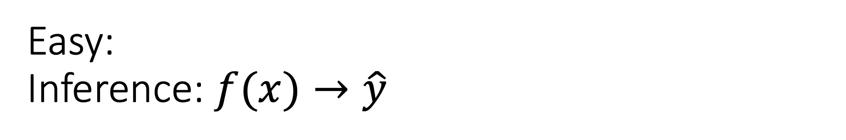
Easy: Inference: $f(x)→\hat{y}$
Classification
Sentiment
Emotion
Hate Speech
Guess Missing Word
Part of Speech Tagging
Question Answering (SQuAD)
Entailment (GLUE)
Machine Translation
Speech
Speech-to-Text
Text-to-Speech
Vision
Classify Objects
Add Captions
HuggingFace

Slide 3

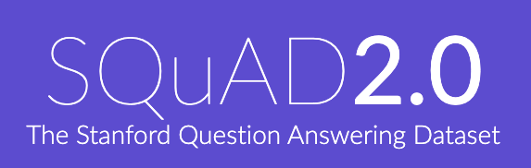
Two Popular Datasets
https://gluebenchmark.com/
https://rajpurkar.github.io/SQuAD-explorer/

Slide 4
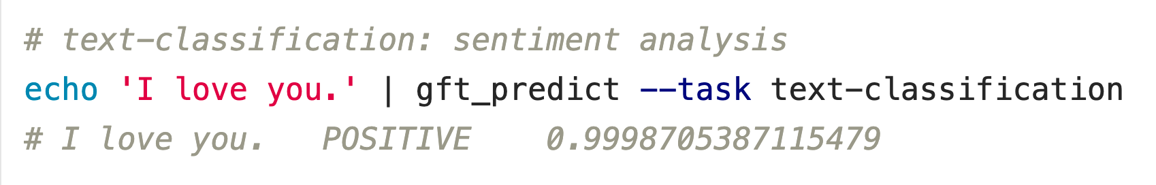



Classification
$$f\left(x\right)→\hat{y}$$
No model specified
$$x$$
$$\hat{y}$$
Score

Slide 5
Input: I love you Output: Depends on Model (among other things)
Task: classify
Models:
Sentiment
Expected output label: positive
Fake News:
Expected output label: not fake (real)
Spam/Ham:
Expected output label: not spam (ham)
for model in …
do
echo I love you |
gft_predict \
--task classify \
--model $model
done

Slide 6
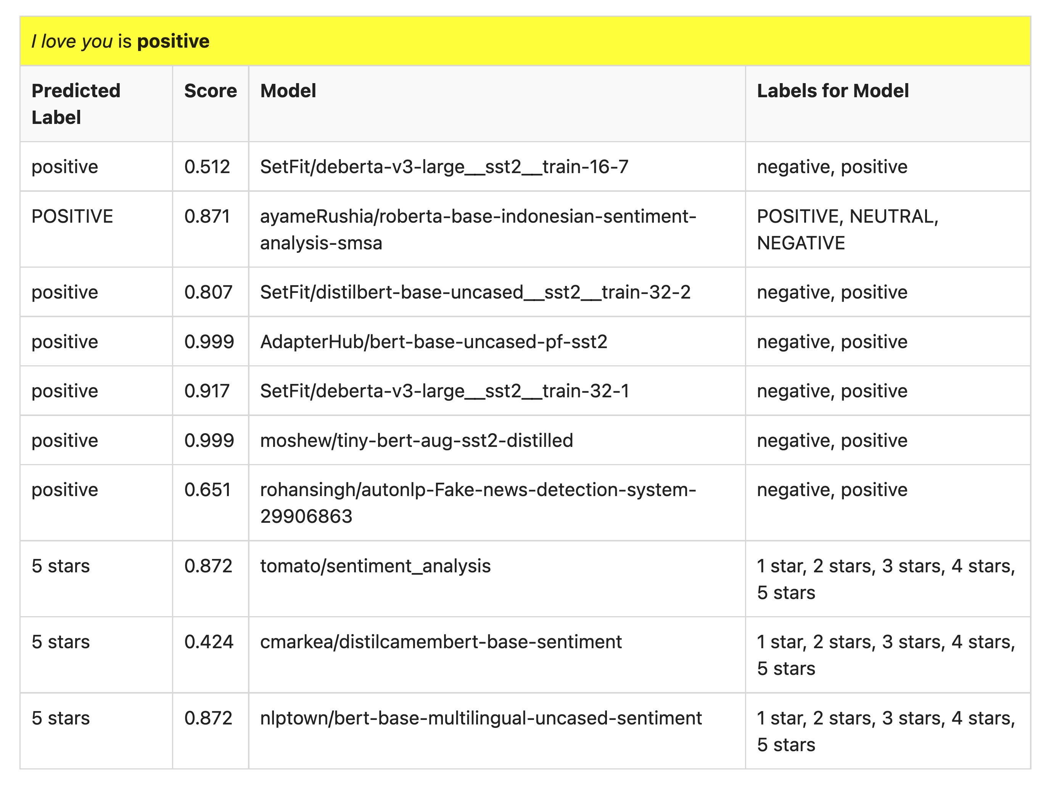
Many of these models produce reasonable results
Scores could be more confident

Slide 7
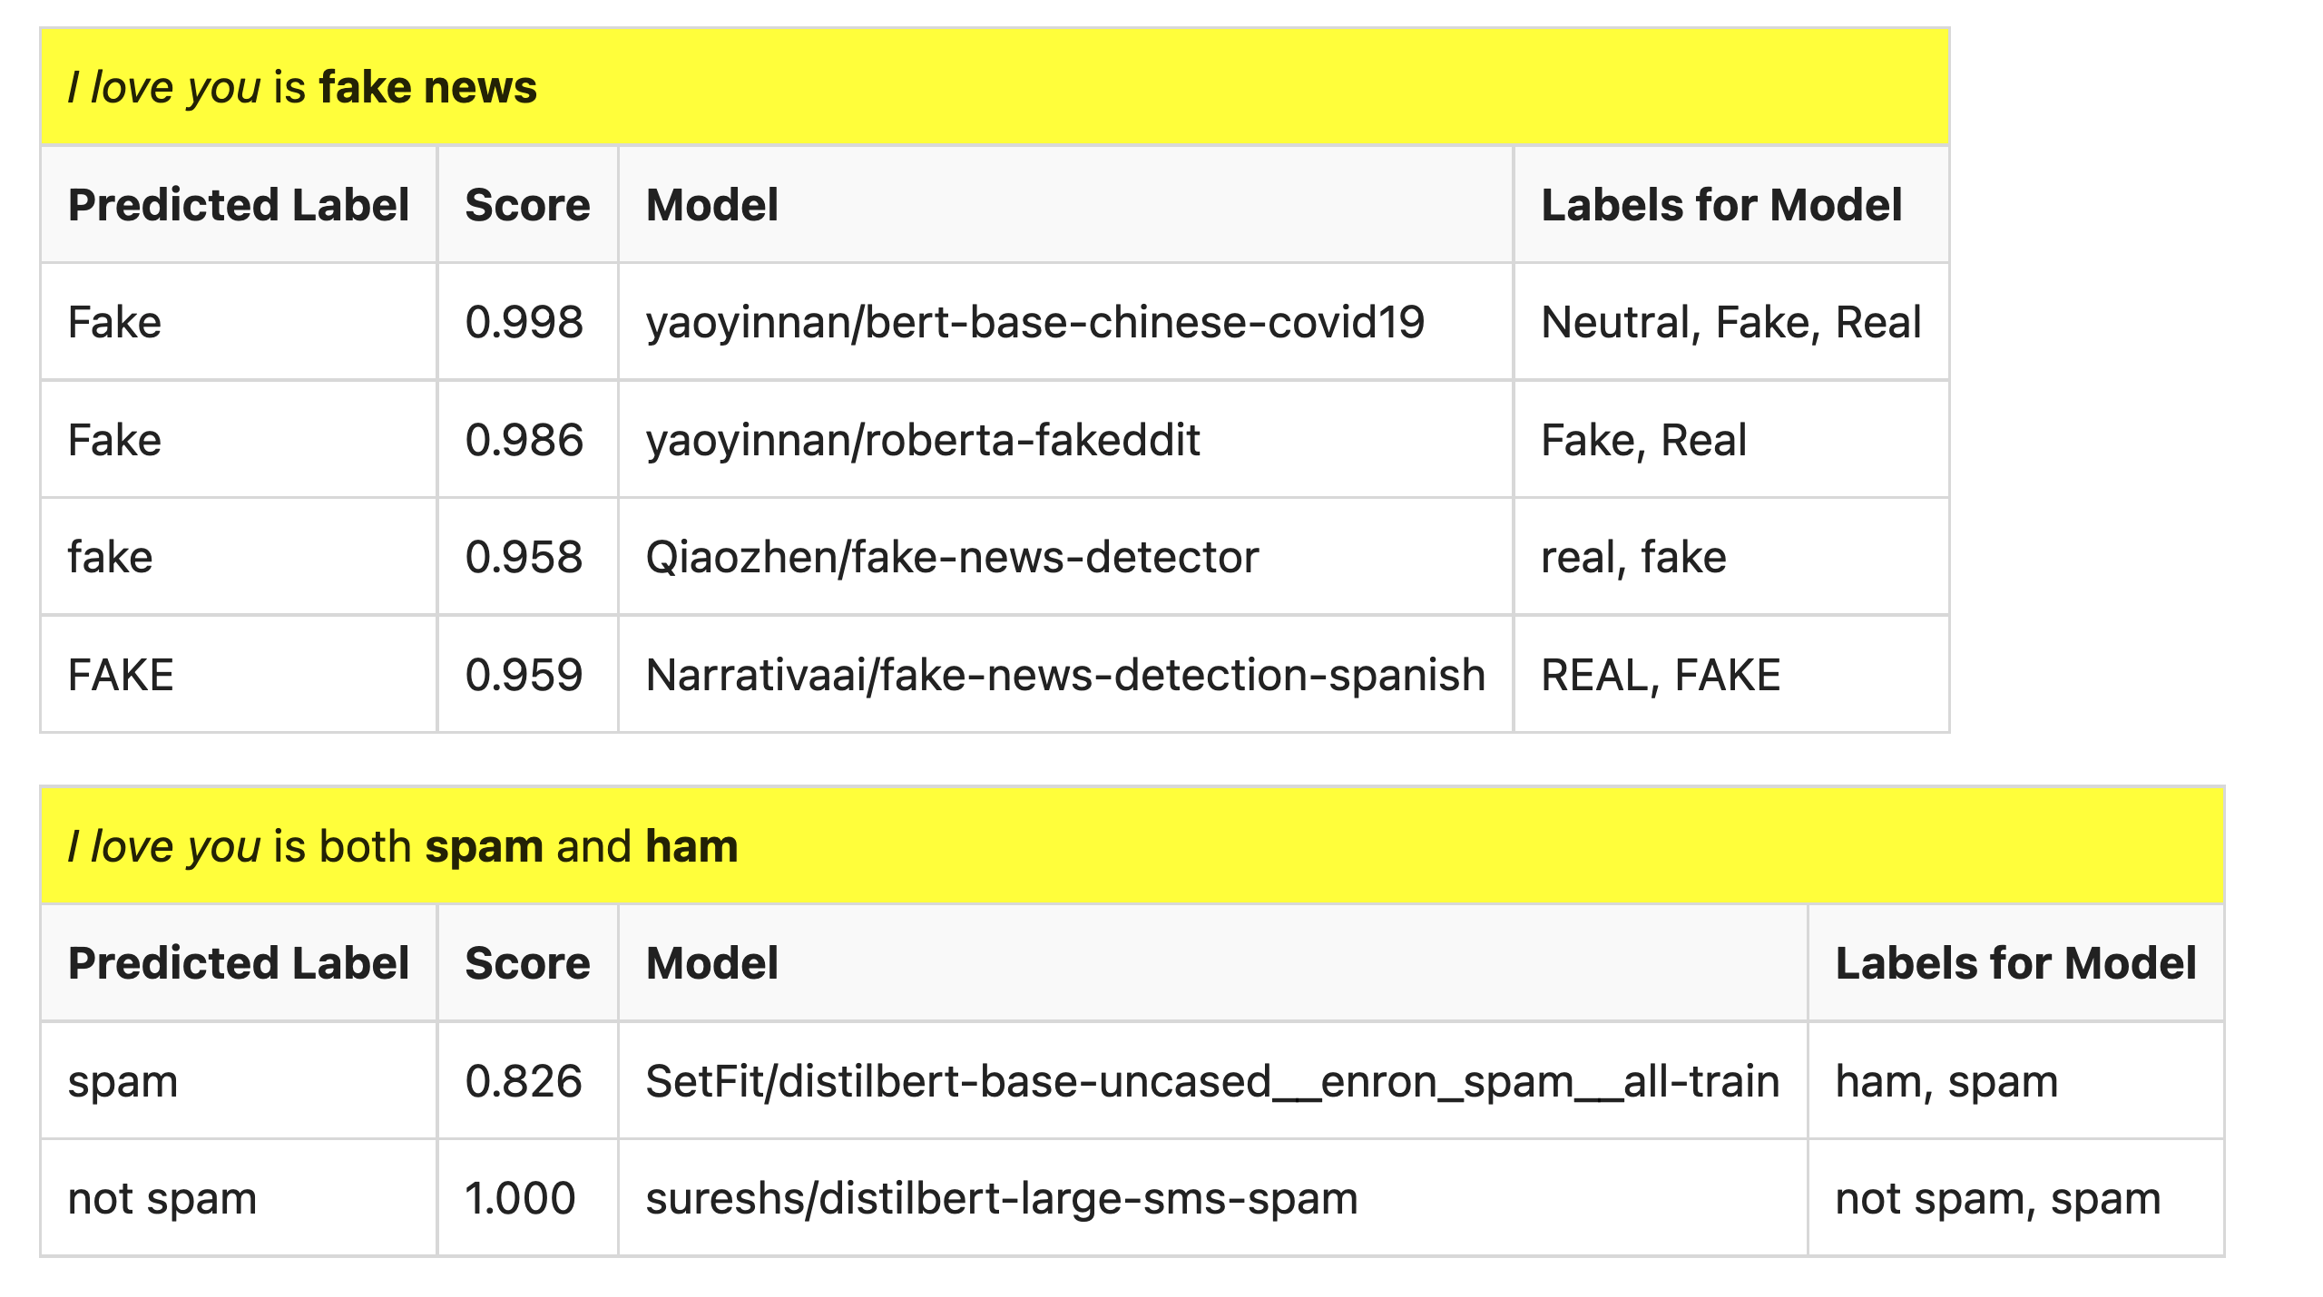
But…

Slide 8
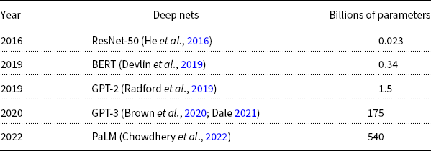
Hard: Pre-Training Large Language Models (LLMs)
GPT-3
PaLM
GPT-2
BERT
ResNet
Most users should not invest in pretraining
because growth (& costs) are out of control

Slide 9

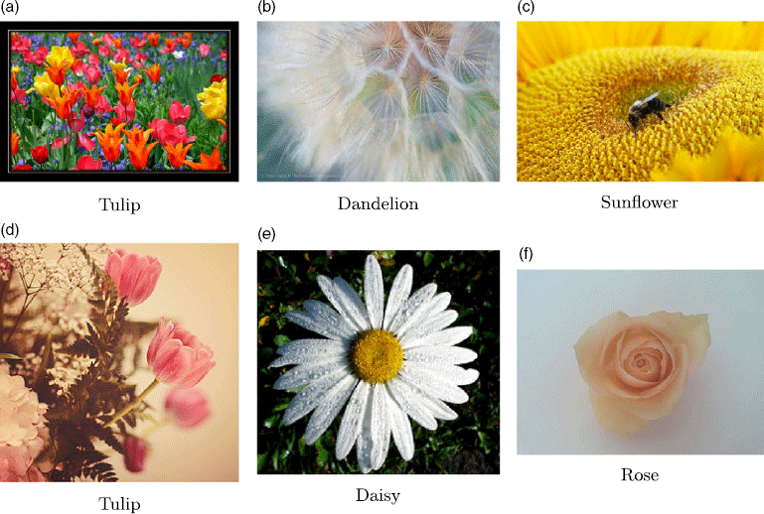
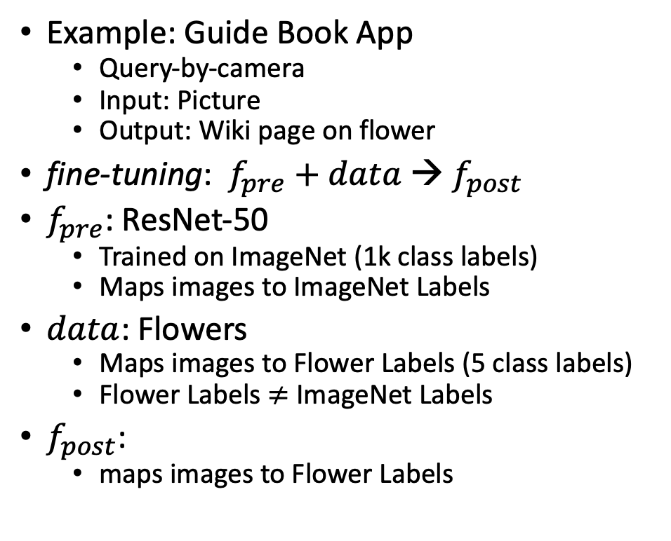

Not So Hard: Fine-Tuning
$$data$$
Flowers
Example: Guide Book App
Query-by-camera
Input: Picture
Output: Wiki page on flower
fine-tuning: $f_{pre}$ $+ data$→ $f_{post}$
$f_{pre}$: ResNet-50
Trained on ImageNet (1k class labels)
Maps images to ImageNet Labels
$data$: Flowers
Maps images to Flower Labels (5 class labels)
Flower Labels $≠$ ImageNet Labels
$f_{post}$:
maps images to Flower Labels

Slide 10
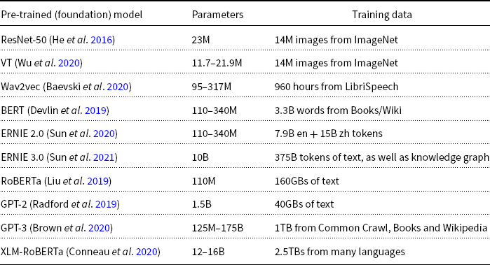
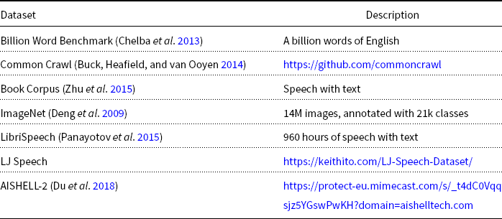
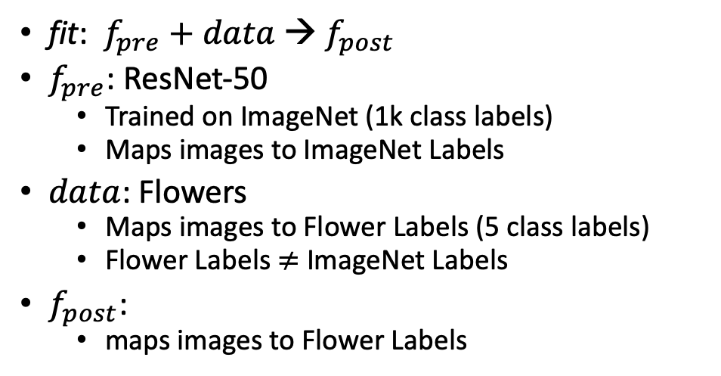

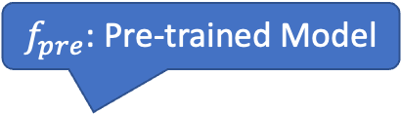
What is fine-tuning fit?
Flowers
$$data$$
fit: $f_{pre}$ $+ data$→ $f_{post}$
$f_{pre}$: ResNet-50
Trained on ImageNet (1k class labels)
Maps images to ImageNet Labels
$data$: Flowers
Maps images to Flower Labels (5 class labels)
Flower Labels $≠$ ImageNet Labels
$f_{post}$:
maps images to Flower Labels
$f_{pre}$: Pre-trained Model

Slide 11
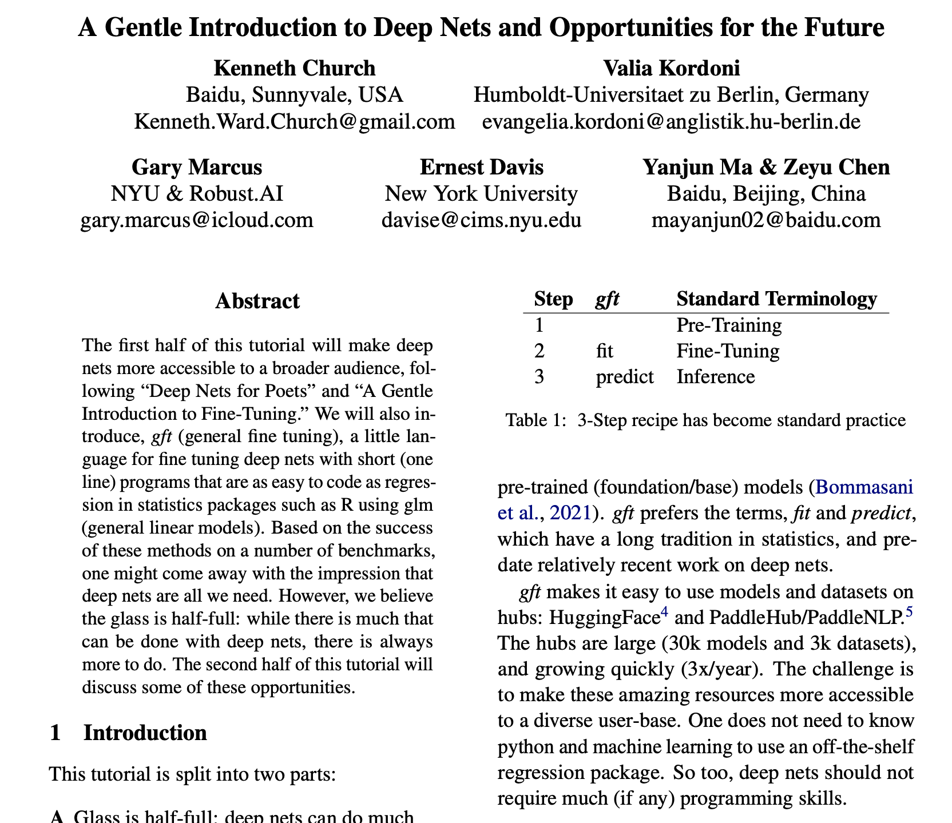
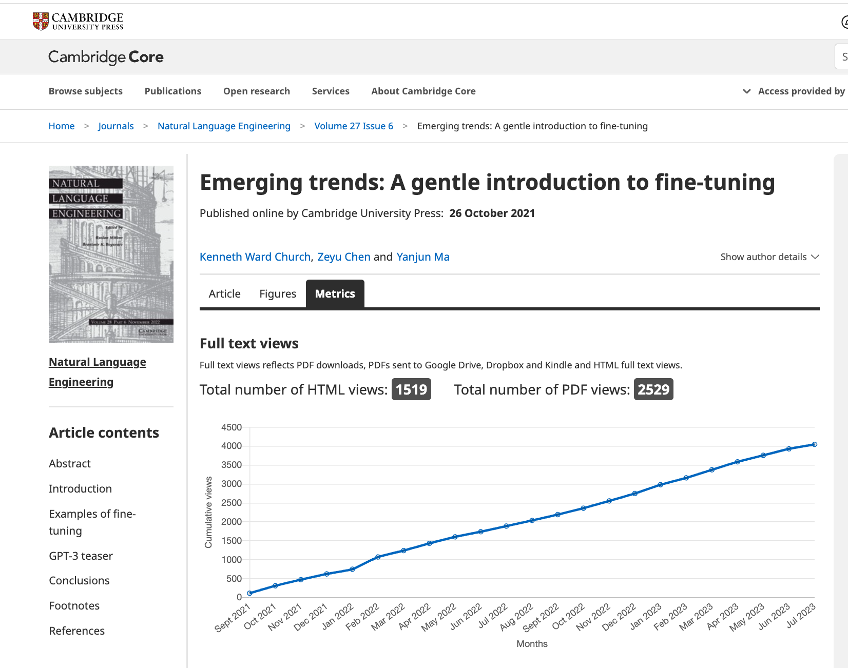
Shameless Plugs
https://github.com/kwchurch/ACL2022_deepnets_tutorial

Slide 12
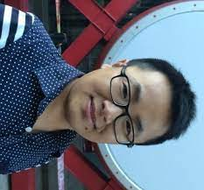
ACL-2022 Tutorial: Part A: Simple Uses of Deep Nets
Ken
Valia
Gary
Ernie
Yanjun
Zeyu
Ken Church, Baidu, USA
Valia Kordoni, Humboldt-Universitaet zu Berlin, Germany
Gary Marcus, Robust.AI
Ernest Davis, NYU
Yanjun MA, Baidu, China
Zeyu Chen, Baidu, China

Slide 13
Outline
Make deep nets accessible to masses (including non-programmers)
Part A: Glass is half-full
Deep nets can do much
Part B: Glass is half-empty
There is always more work to do
Advocate combo of Part A with
AI Knowledge Representation
Linguistics and Philosophy
GFT Code,
100s of examples,
slides, videos, papers

Slide 14
Agenda: Part A
Strategy
gft Cheatsheet
4-5 Functions + 4 Arguments
Amazing how much can be done with so little
Seven Simple Examples
More Tasks: MT, ASR, Vision
Two Questions
How do we find the good stuff?
How do we use the good stuff?
Why de-emphasize pre-training?
Conclusions

Slide 15
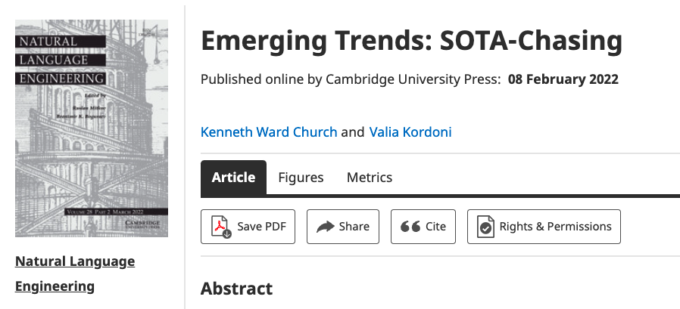
Strategy: Inclusiveness
Get your priorities right: Inclusiveness >> Exclusiveness
SOTA-Chasing 👎 (Exclusive: mine is bigger than yours)
Crossing the Chasm 👍 (Inclusive: Appeal to mainstream users)
Hubs: Get big quick 👍 (Inclusive: Usage >> SOTA)

Slide 16
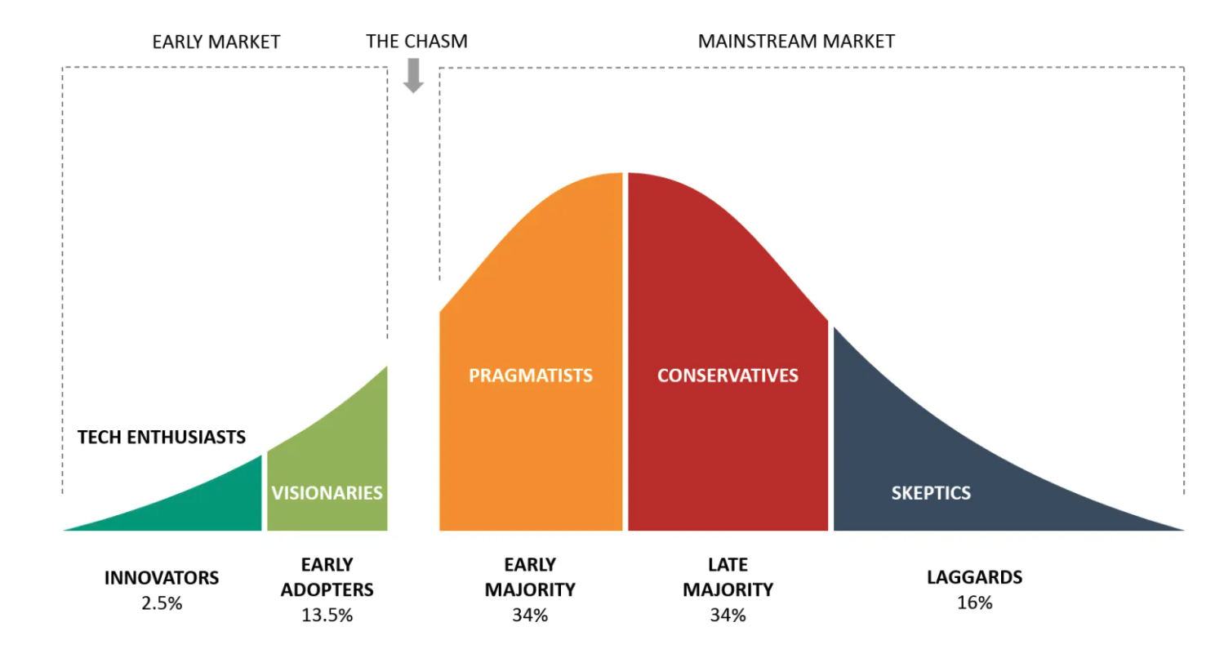
Bigger Opportunities:
(l)users (aka poets)
Engineers

Slide 17
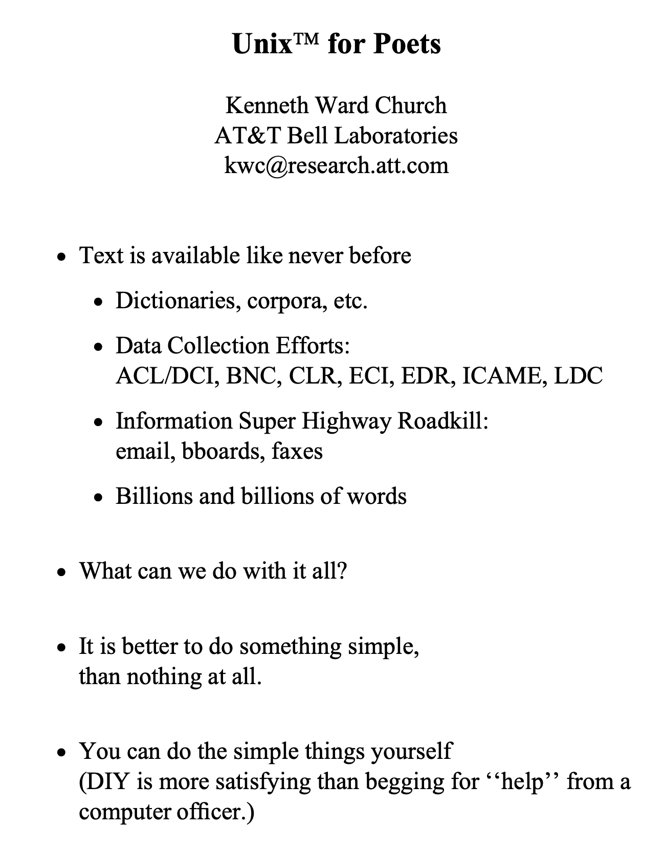
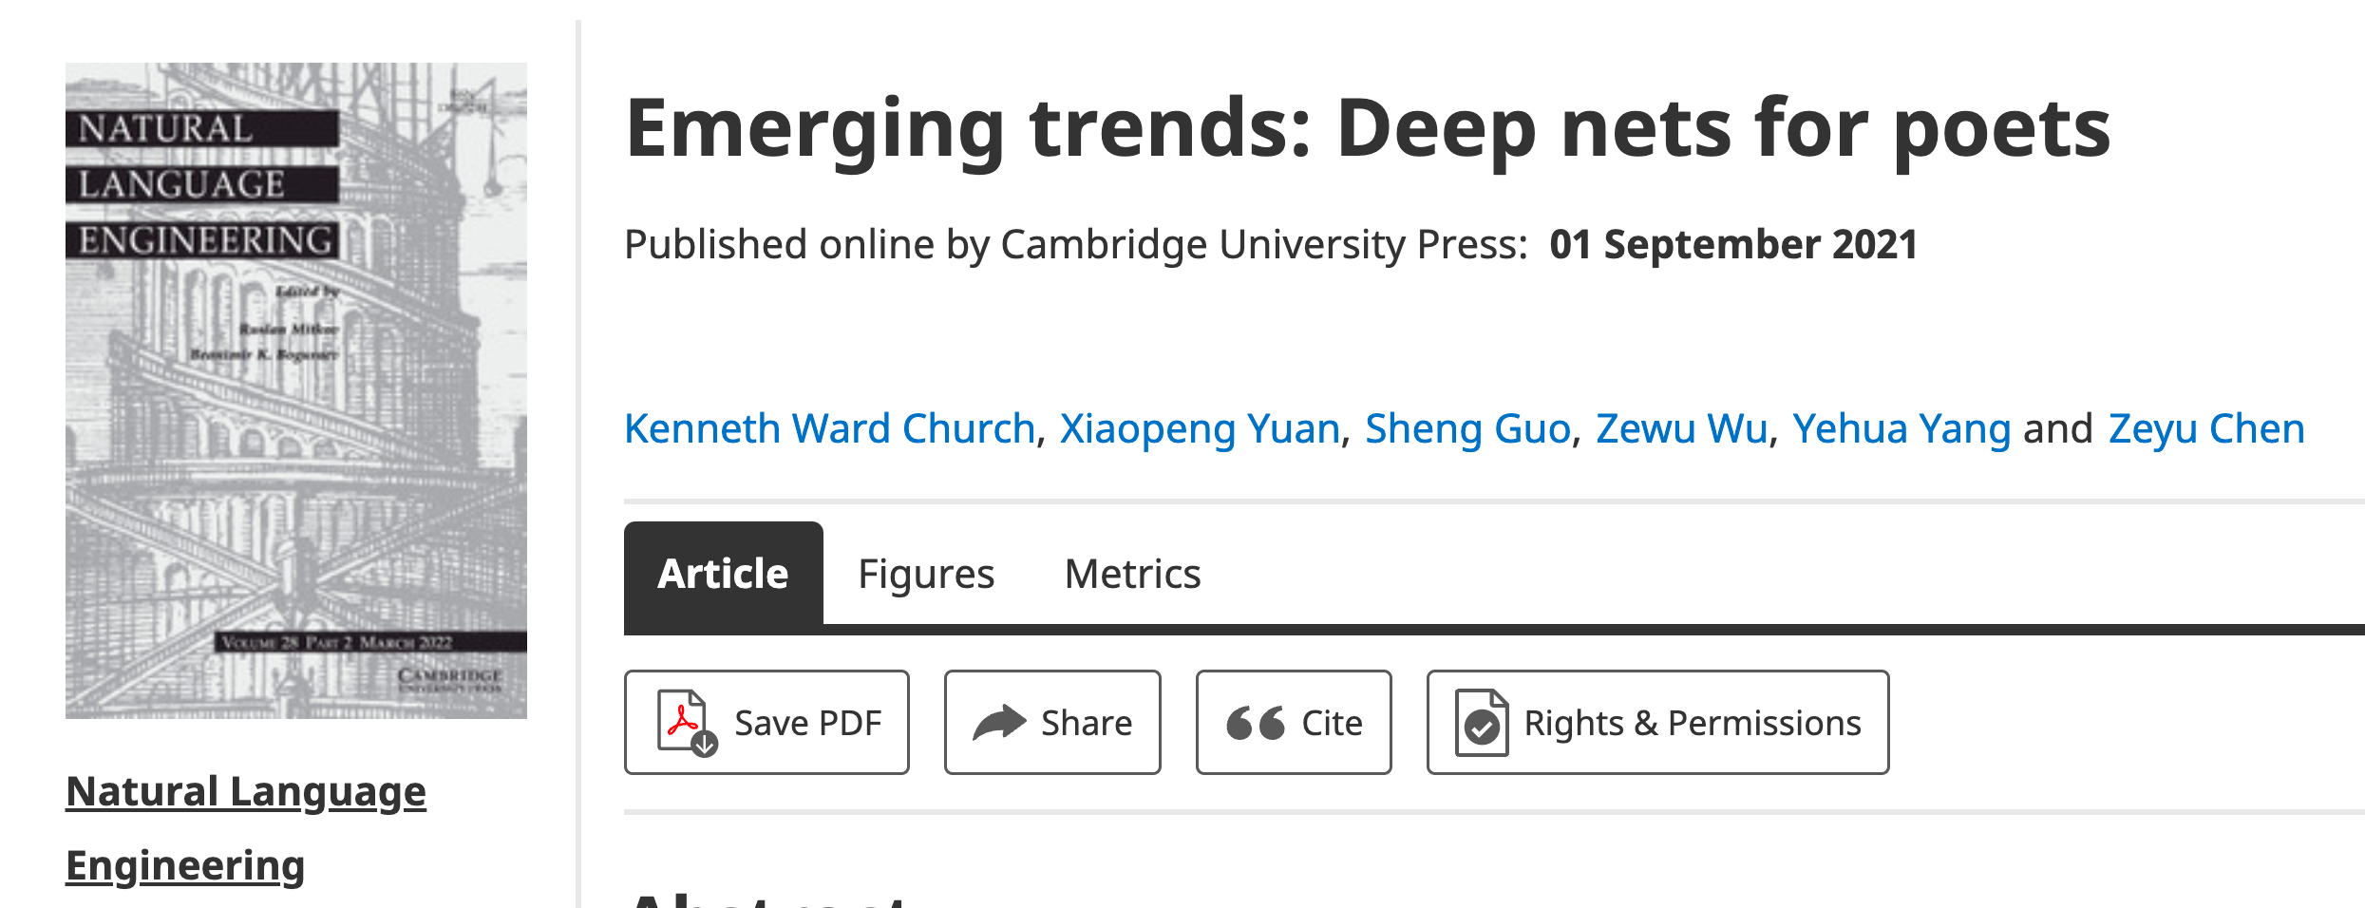
Poets
Poets is an imperfect metaphor,
intended as a gesture toward inclusion.
The future for deep nets
will benefit by reaching out to
a broad audience of potential users,
including people with
little or no programming skills,
and little interest in training models.
Lessons from success of Unix
Less is more
Inclusion: Appeal to power users as well as masses
Portability: Inclusiveness++

Slide 18
Hub Strategy: Usage >> SOTA
(Sensible) Priority for Startups
(Mistaken) Priority Research
Startup Strategy:
Get big quick
SOTA is like sprinting (hard work)
Avoid temptation to sprint to front
(except when it is worth the effort)
Hubs spend most of the race
in the peloton drafting researchers
Make it easy for 3rd parties
to post their best models on your hub
Use of 3rd parties → Wide range in quality
Best are amazing: best in class, industrial strength…
But some don’t work well, and may not even load…
Help users find good stuff

Slide 19
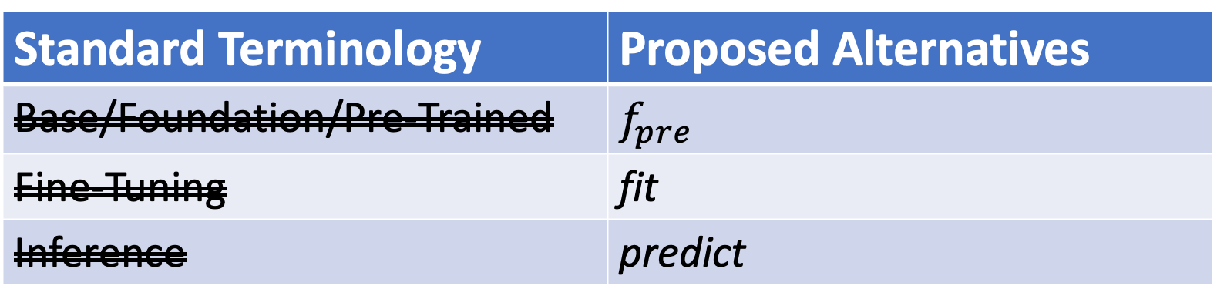
Terminology
0-shot
Standard Terminology | Proposed Alternatives
Base/Foundation/Pre-Trained | $$f_{pre}$$
Fine-Tuning | fit
Inference | predict
Unsupervised
Supervised
Emphasize this
Emphasize this
Few-shot
De-emphasize this
Teaser: Stay-tuned

Slide 20
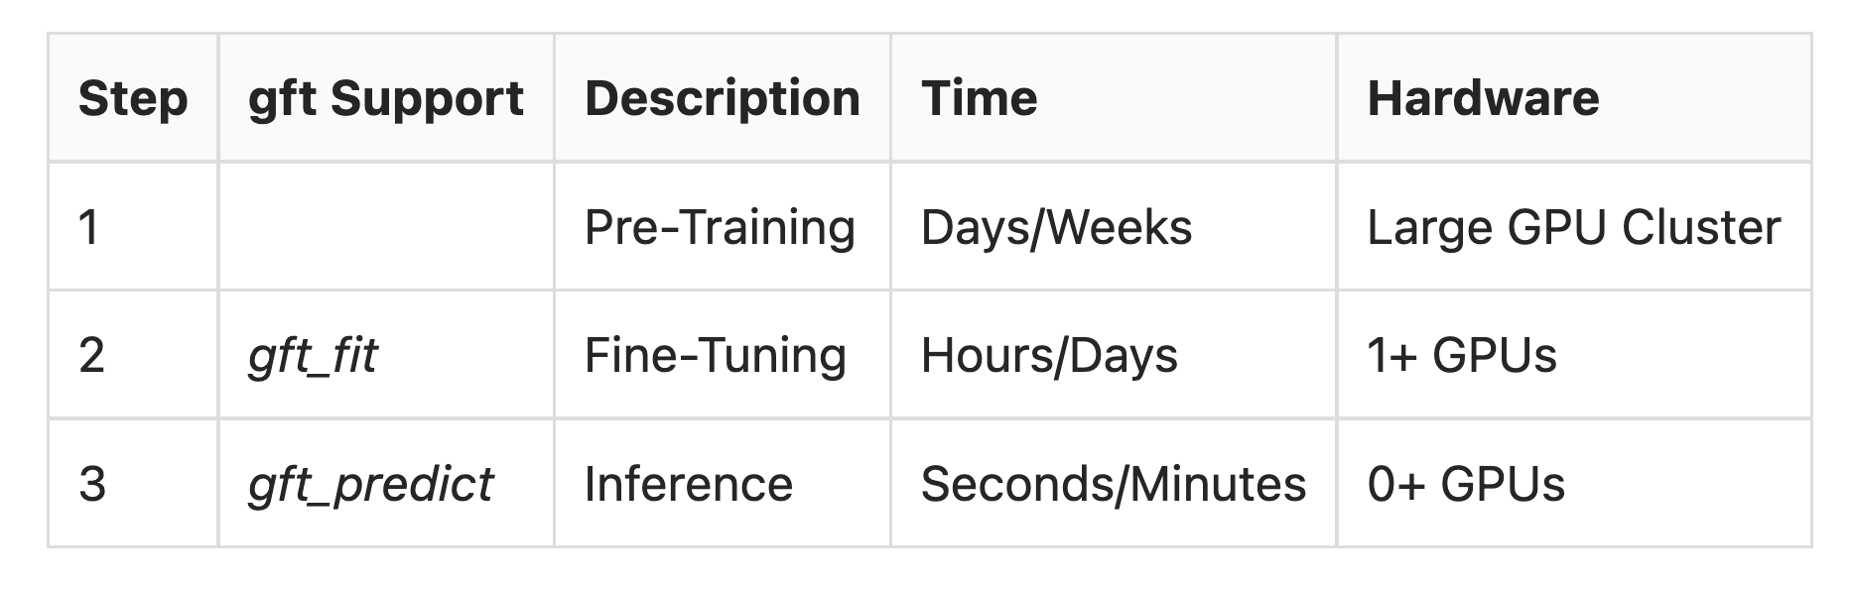
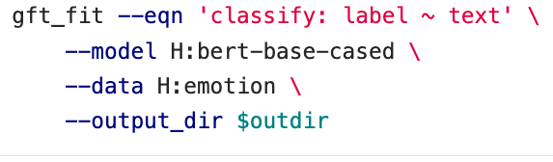

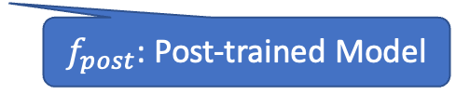
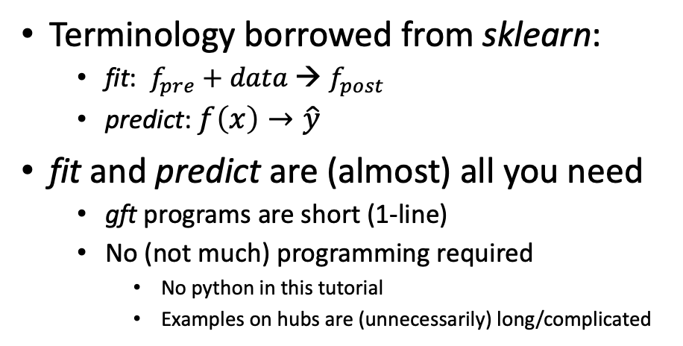
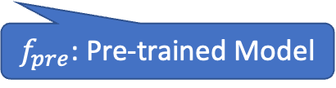

gft (general fine-tuning): A Little Language for Deep Nets (Unix Philosophy: Less is More)
Standard 3-Step Recipe
Examples of 1-line GFT Programs
Step 2: gft_fit
Data
$f_{pre}$: Pre-trained Model
Terminology borrowed from sklearn:
fit: $f_{pre}$ $+ data$→ $f_{post}$
predict: $f\left(x\right)→\hat{y}$
fit and predict are (almost) all you need
gft programs are short (1-line)
No (not much) programming required
No python in this tutorial
Examples on hubs are (unnecessarily) long/complicated
$f_{post}$: Post-trained Model
Step 3: gft_predict
$$x$$
$$\hat{y}$$
Score

Slide 21
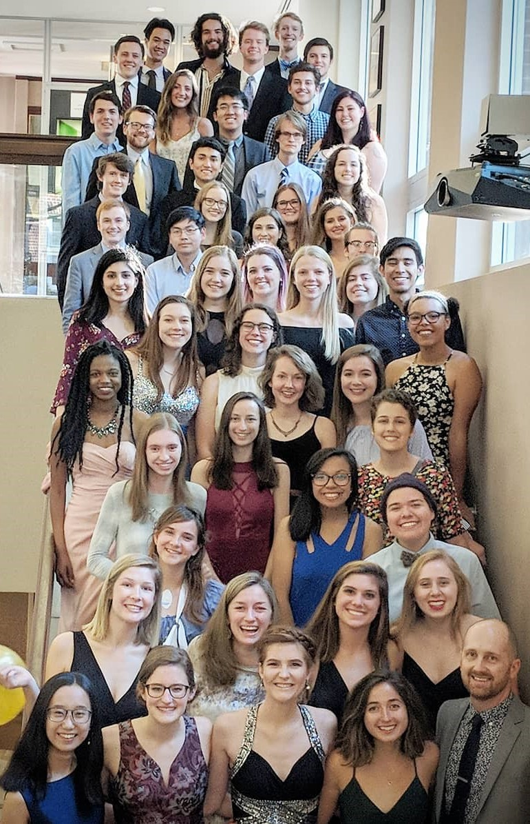
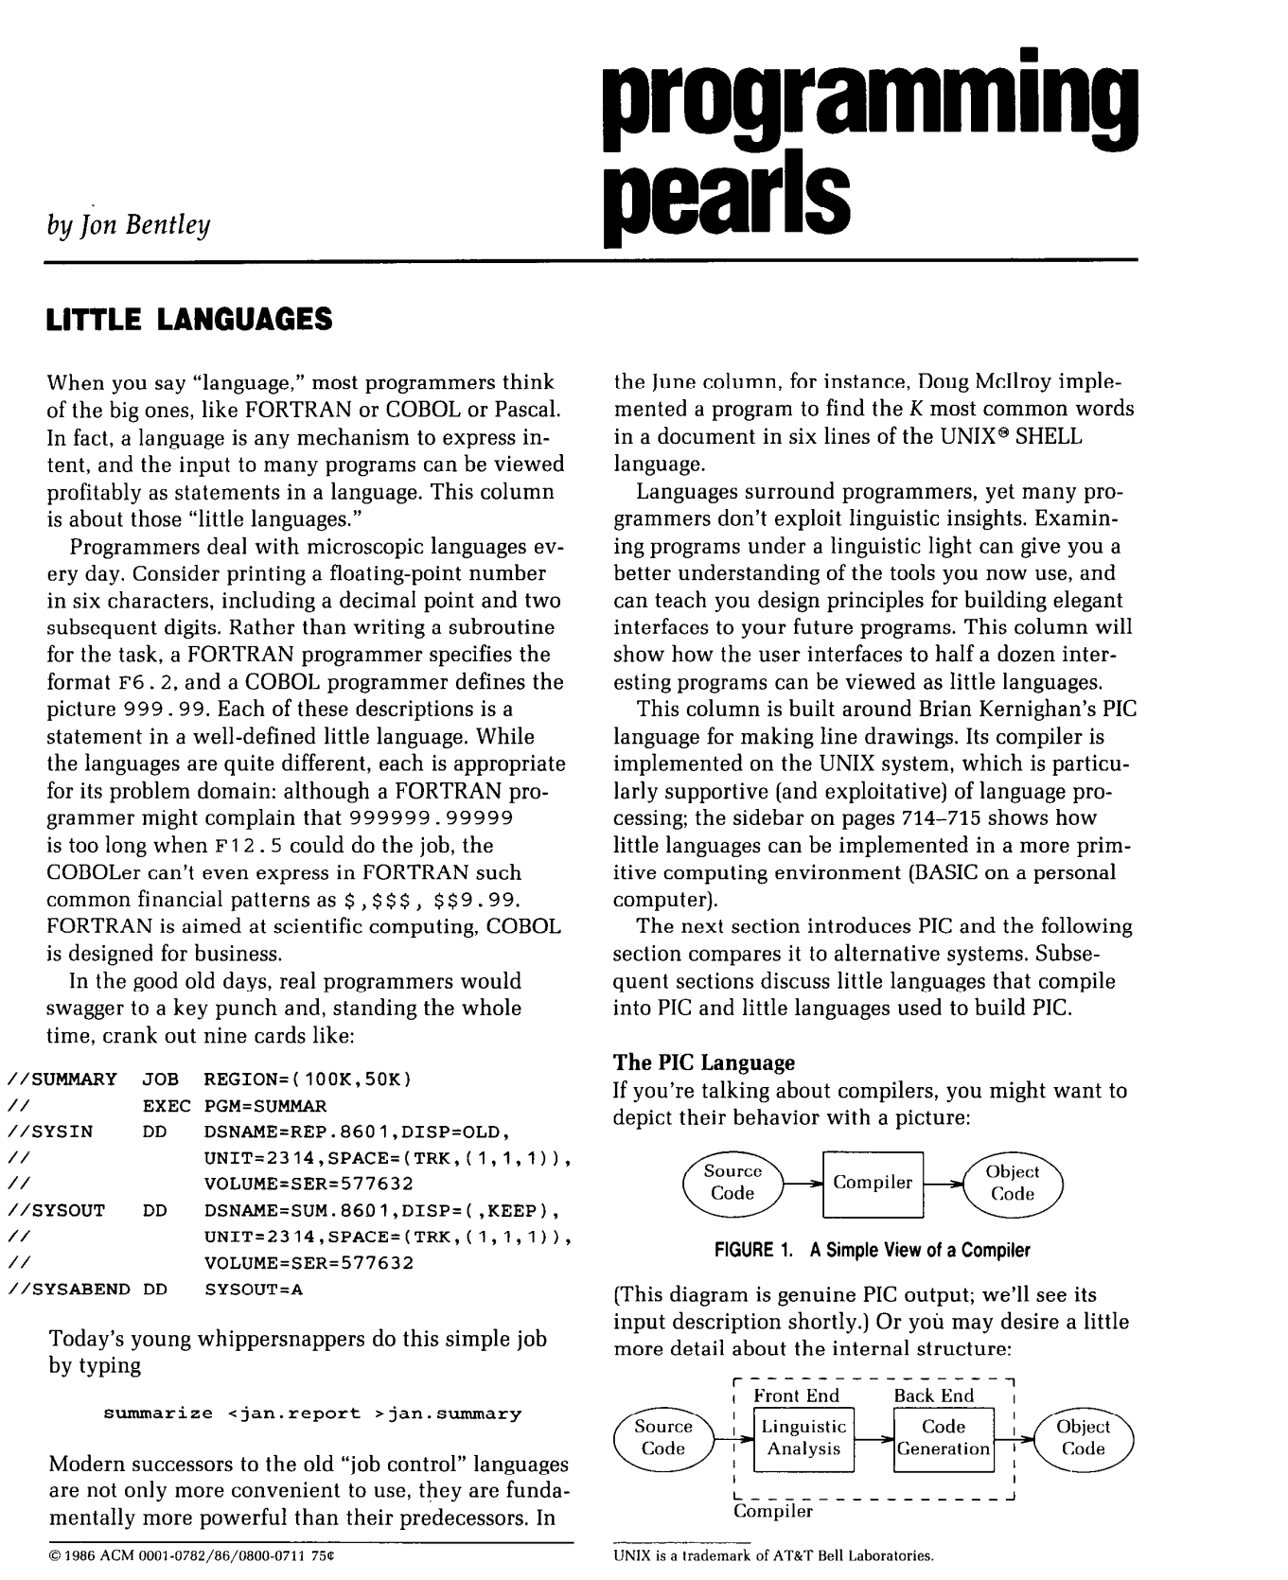
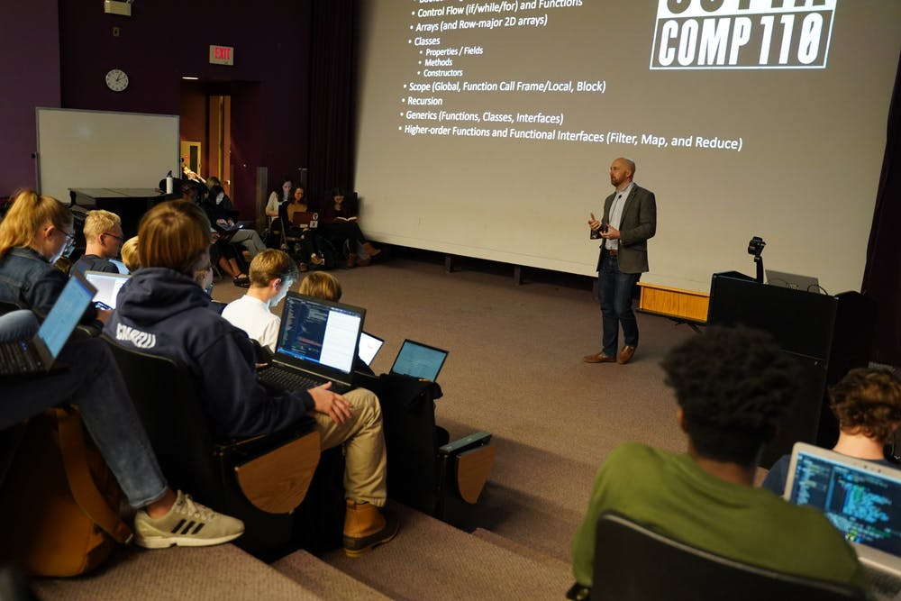

Little Languages (from Unix)
Bentley (CACM-1986)
https://comp590-19s.github.io/
Kris Jordan (UNC Chapel Hill, 2019)

Slide 22
Little Languages (from Unix)
Bentley (CACM-1986)
https://comp590-19s.github.io/
Kris Jordan (UNC Chapel Hill, 2019)

Slide 23
We propose gft, a Little Language
In the good old days,
real programmers would copy a few hundred lines of PyTorch from HuggingFace
and modify as necessary to change
models,
datasets,
task,
etc.
With gft, 100s of lines → 1-line
More accessible to masses
(including non-programmers)

Slide 24
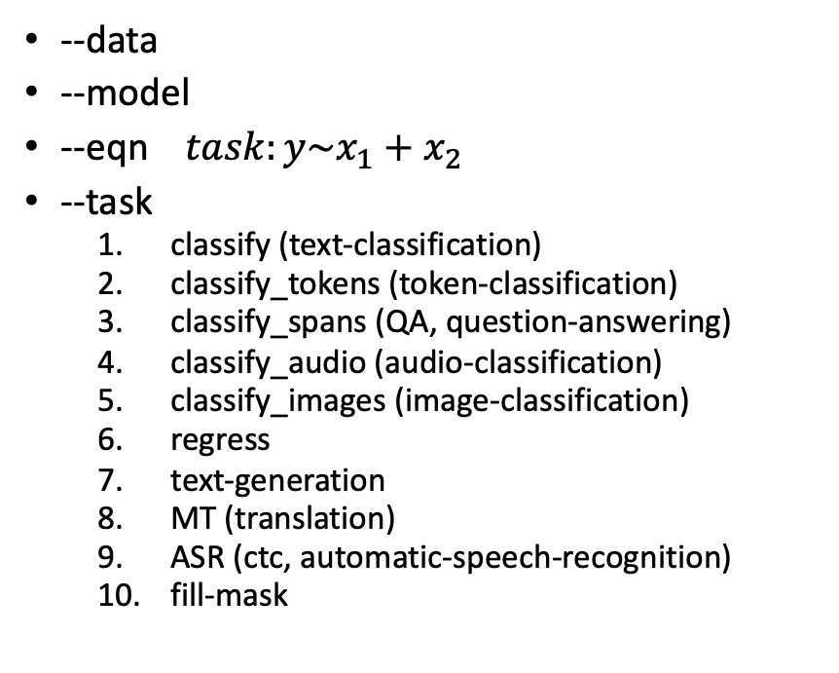
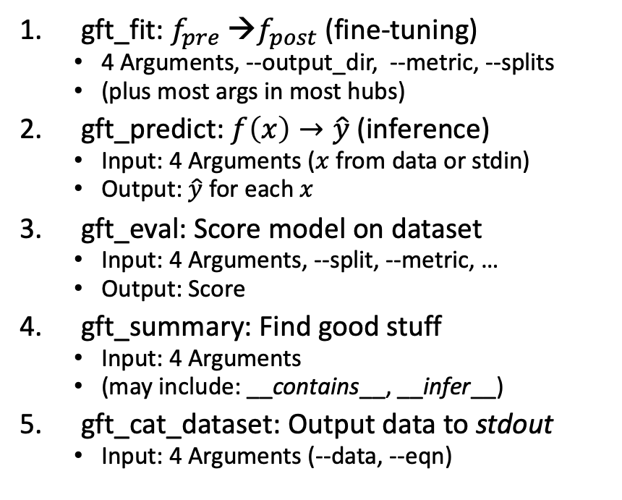
gft Cheat Sheet (General Fine-Tuning)
Amazing how much can be done with so little
4+1 Functions
4 Arguments
gft_fit: $f_{pre}$ →$f_{post}$(fine-tuning)
4 Arguments, --output_dir, --metric, --splits
(plus most args in most hubs)
gft_predict: $f\left(x\right)→\hat{y}$ (inference)
Input: 4 Arguments ($x$ from data or stdin)
Output: $\hat{y}$ for each $x$
gft_eval: Score model on dataset
Input: 4 Arguments, --split, --metric, …
Output: Score
gft_summary: Find good stuff
Input: 4 Arguments
(may include: __contains__, __infer__)
gft_cat_dataset: Output data to stdout
Input: 4 Arguments (--data, --eqn)
--data
--model
--eqn $task:y\sim x_{1}+x_{2}$
--task
classify (text-classification)
classify_tokens (token-classification)
classify_spans (QA, question-answering)
classify_audio (audio-classification)
classify_images (image-classification)
regress
text-generation
MT (translation)
ASR (ctc, automatic-speech-recognition)
fill-mask

Slide 25
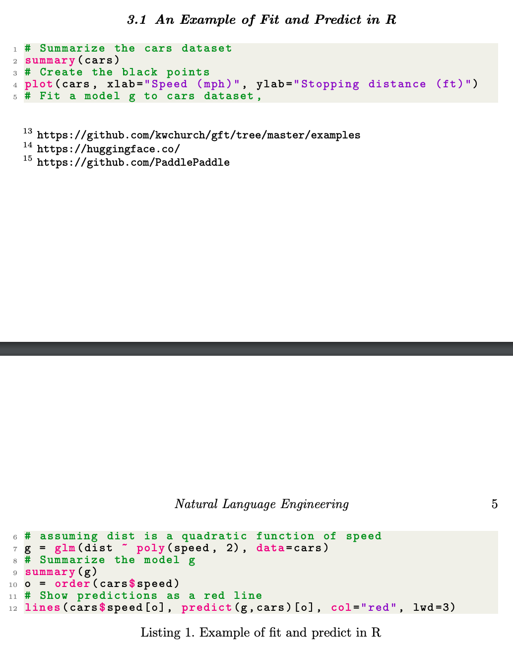
gft (General Fine-Tuning) is based on glm (General Linear Models) in R
Make deep nets look like regression
(Not much programming)

Slide 26
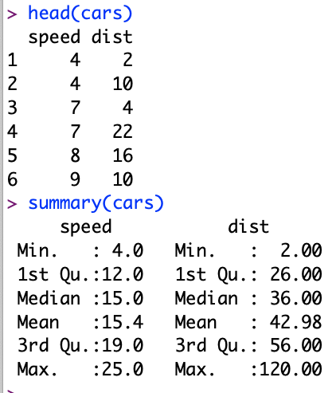
Regression in R: Summarize (almost) anything
Black Points:
cars dataset
Summarize a dataset (cars)
Red Line:
Model (g)

Slide 27
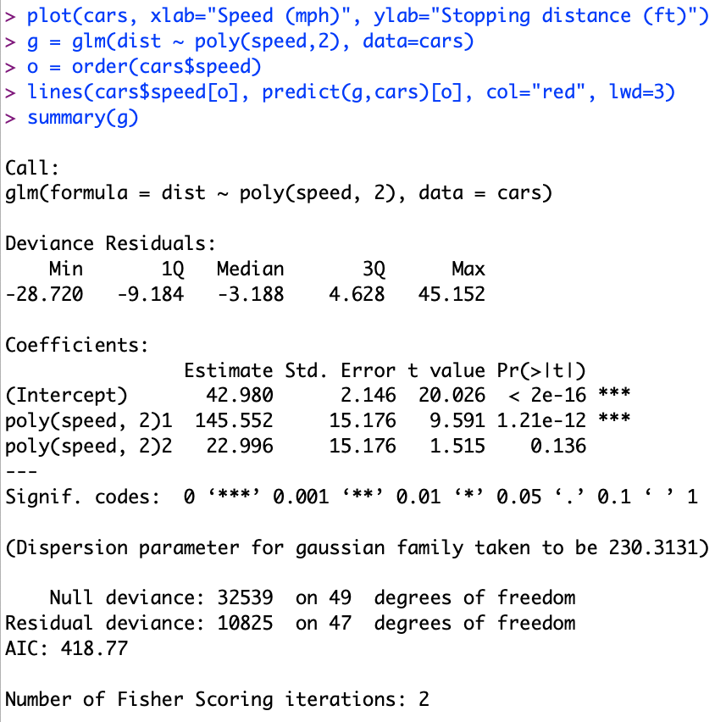
Regression in R: Summarize (almost) anything
Fit a model (g) to data (cars)

Slide 28
Regression in R: Summarize (almost) anything
Fit a model (g) to data (cars)
Predict
Summarize a model (g)
Opportunity to Improve g

Slide 29
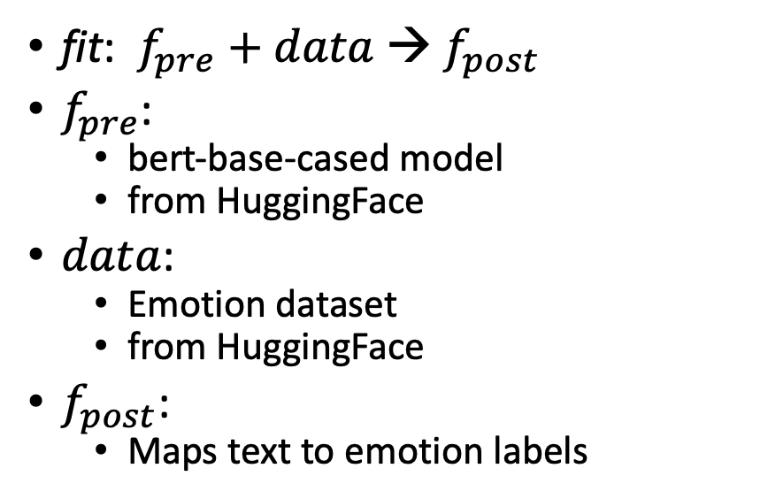
What is fine-tuning fit?
fit: $f_{pre}$ $+ data$→ $f_{post}$
$f_{pre}$:
bert-base-cased model
from HuggingFace
$data$:
Emotion dataset
from HuggingFace
$f_{post}$:
Maps text to emotion labels
R Program
gft Program

Slide 30
What is fine-tuning fit?
Flowers
$$data$$
fit: $f_{pre}$ $+ data$→ $f_{post}$
$f_{pre}$: ResNet-50
Trained on ImageNet (1k class labels)
Maps images to ImageNet Labels
$data$: Flowers
Maps images to Flower Labels (5 class labels)
Flower Labels $≠$ ImageNet Labels
$f_{post}$:
maps images to Flower Labels
$f_{pre}$: Pre-trained Model

Slide 31
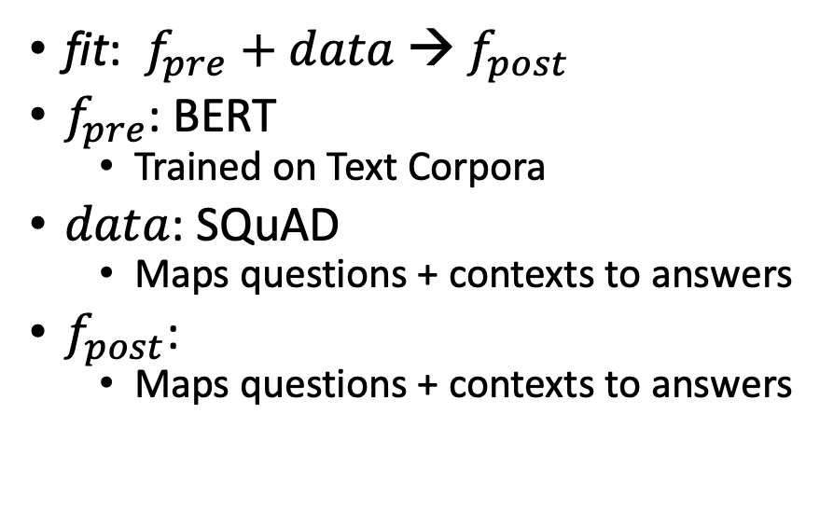
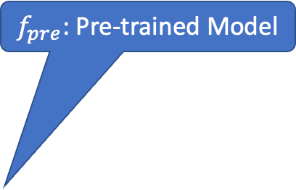
What is fine-tuning fit?
SQuAD
fit: $f_{pre}$ $+ data$→ $f_{post}$
$f_{pre}$: BERT
Trained on Text Corpora
$data$: SQuAD
Maps questions + contexts to answers
$f_{post}$:
Maps questions + contexts to answers
Question:
What does AFC stand for?
Context:
The American Football Conference (AFC) champion Denver Broncos defeated the National Football Conference (NFC) champion Carolina Panthers 24–10 to earn their third Super Bowl title.
Answer:
American Football Conference
Text with no markup
$f_{pre}$: Pre-trained Model

Slide 32
gft Design Goals
Inclusiveness:
Accessible to Masses
(including non-programmers)
Portability
Ease-of-Use/Transparency >> SOTA
Hide Complexity/Magic (Alchemy)
No one would suggest
Regression-like methods are ``intelligent’’

Slide 33
Portability: Inclusiveness + Hedge
gft Programs
H → HuggingFace
gft_fit --model H:bert-base-cased \
--data H:emotion \
--output_dir $1 \
--eqn 'classify: label ~ text'
Hedge
(Supply Chains)
Hedge
(Supply Chains)
P → PaddleNLP
gft_fit --model P:ernie-tiny \
--data P:chnsenticorp \
--output_dir $1 \
--eqn 'classify: label ~ text'
Emphasis on Chinese

Slide 34
Strategy Conclusions
Inclusiveness
Appeal to Power Users as well as Masses
Accessible to Masses
Portability
Transparency
Avoid Magic / Alchemy
Hide Complexity
Embrace Historical Precedents
Little Languages from Unix
Fit/Predict/Summary/glm Equations from R

Slide 35
Agenda: Part A
Strategy
gft Cheatsheet
4-5 Functions + 4 Arguments
Amazing how much can be done with so little
Seven Simple Examples
More Tasks: MT, ASR, Vision
Two Questions
How do we find the good stuff?
How do we use the good stuff?
Why de-emphasize pre-training?
Conclusions

Slide 36
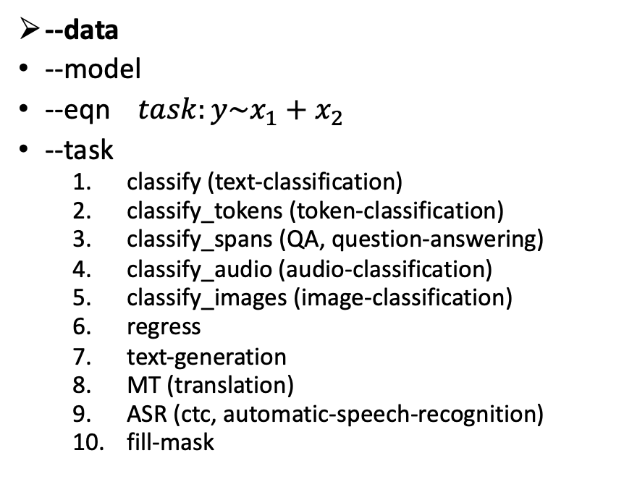
gft Cheat Sheet (General Fine-Tuning)
Next topic
4+1 Functions
4 Arguments
gft_fit: $f_{pre}$ →$f_{post}$(fine-tuning)
4 Arguments, --output_dir, --metric, --splits
(plus most args in most hubs)
gft_predict: $f\left(x\right)→\hat{y}$ (inference)
Input: 4 Arguments ($x$ from data or stdin)
Output: $\hat{y}$ for each $x$
gft_eval: Score model on dataset
Input: 4 Arguments, --split, --metric, …
Output: Score
gft_summary: Find good stuff
Input: 4 Arguments
(may include: __contains__, __infer__)
gft_cat_dataset: Output data to stdout
Input: 4 Arguments (--data, --eqn)
--data
--model
--eqn $task:y\sim x_{1}+x_{2}$
--task
classify (text-classification)
classify_tokens (token-classification)
classify_spans (QA, question-answering)
classify_audio (audio-classification)
classify_images (image-classification)
regress
text-generation
MT (translation)
ASR (ctc, automatic-speech-recognition)
fill-mask

Slide 37
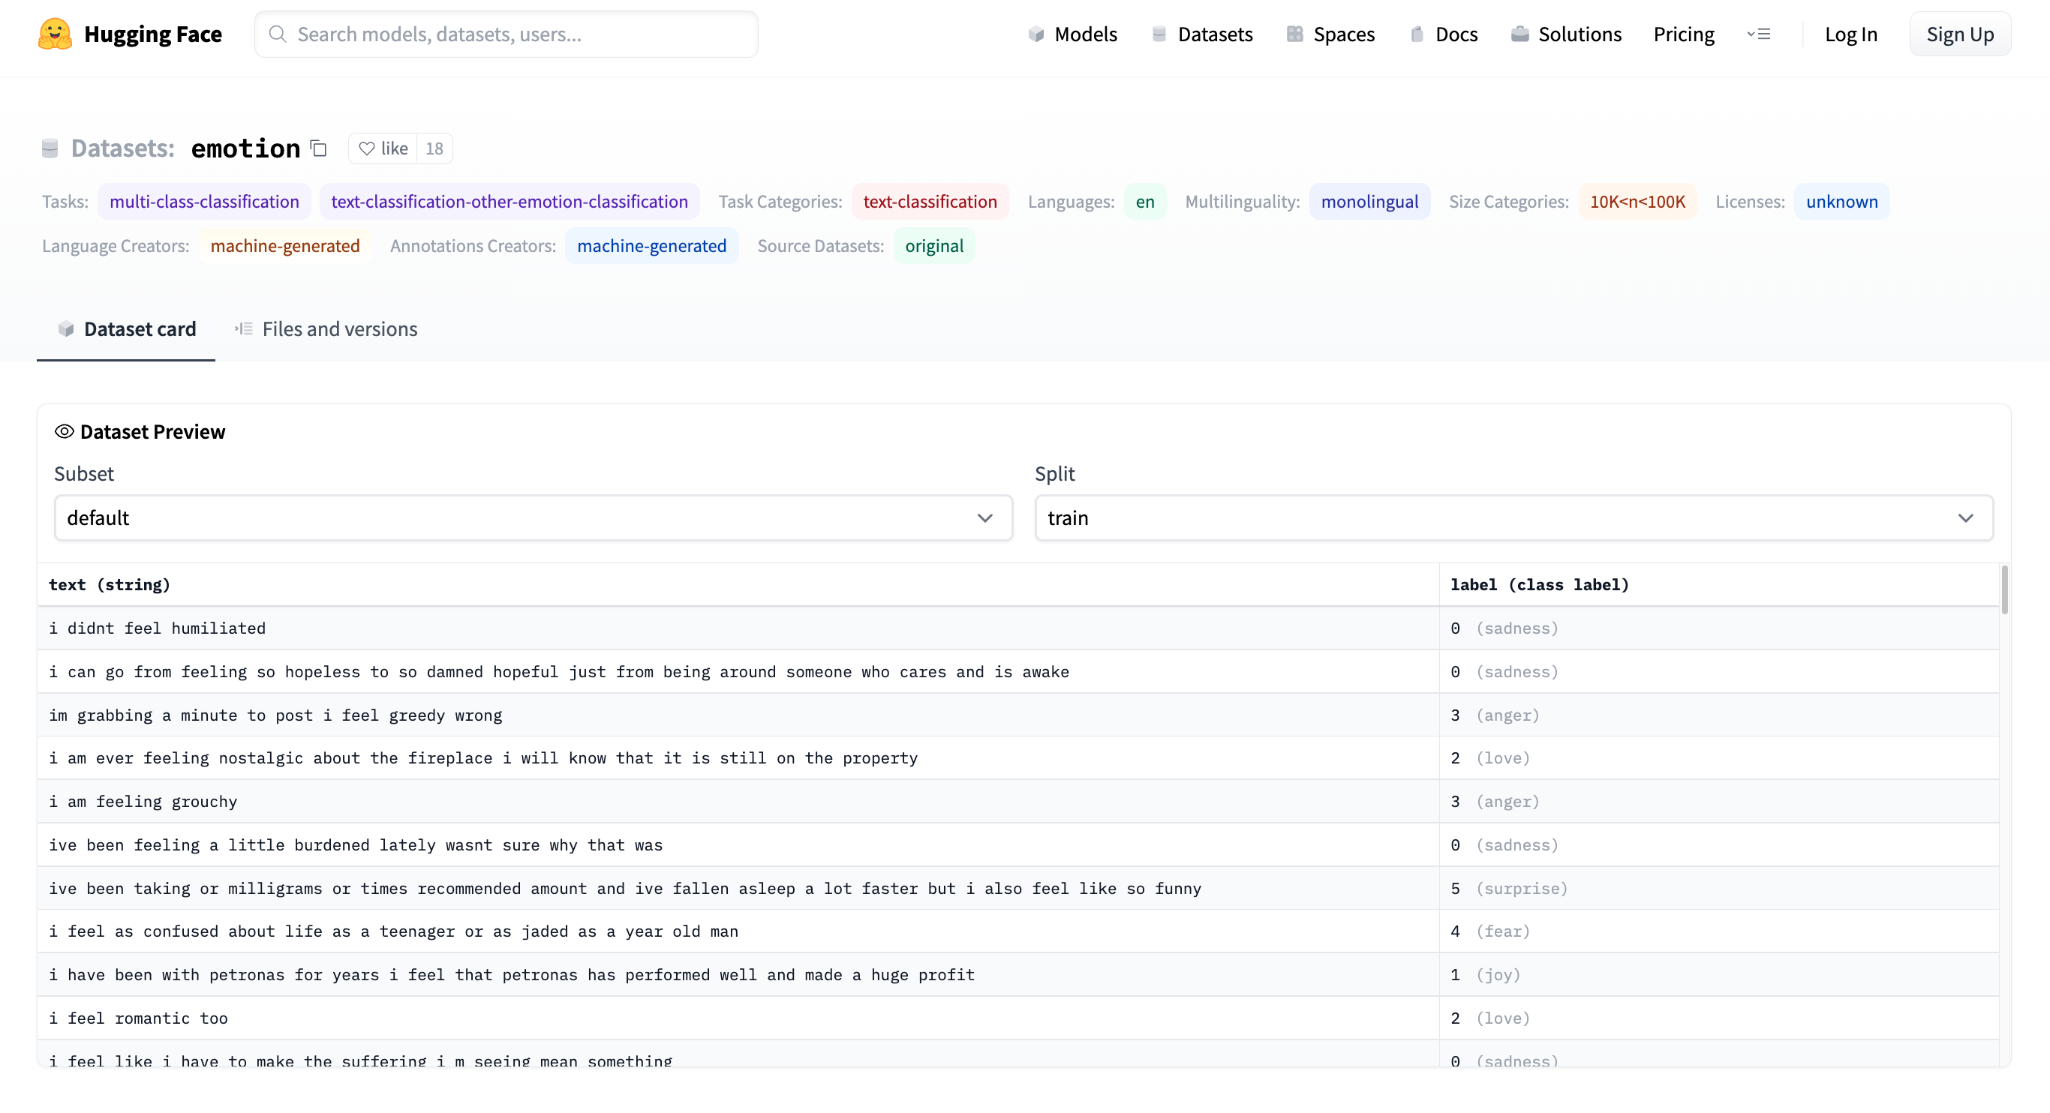
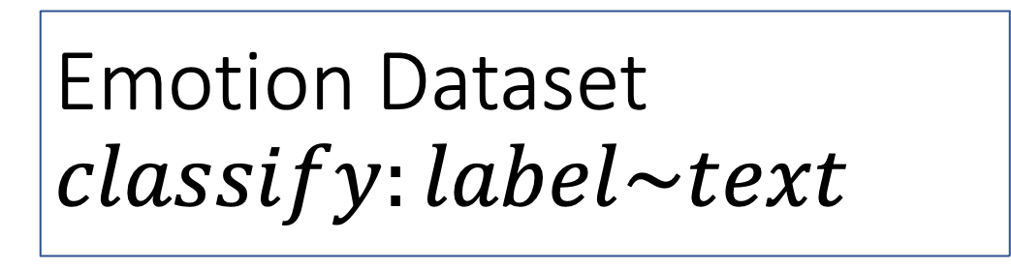
Emotion Dataset $$classify:label\sim text$$
Task
Columns
Columns
Row

Slide 38
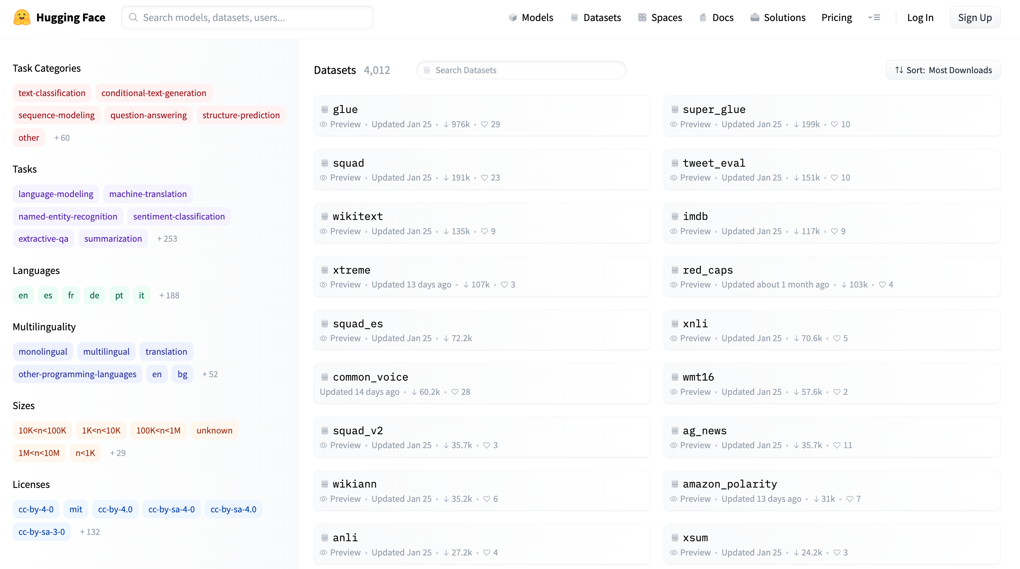
More Terminology
Dataset (4k)
Models (40k)
Tasks
classify
regress
translation
ASR
…
https://huggingface.co/datasets

Slide 39
Two Popular Datasets
https://gluebenchmark.com/
https://rajpurkar.github.io/SQuAD-explorer/

Slide 40
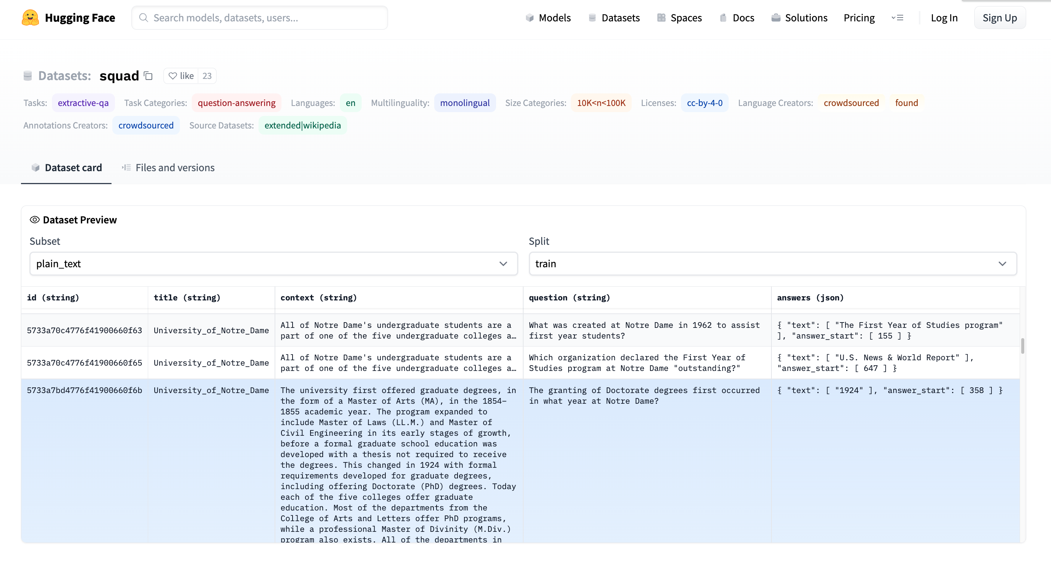
More Terminology
Dataset (4k)
Splits: train, validation, test
Columns:
id, title, context, question, answers
Rows
Models (36k)
Tasks:
classification, regression, etc.
https://huggingface.co/datasets/squad/viewer/plain_text/train

Slide 41
More Terminology
Answer starts at context[358:]
Dataset (4k)
Splits: train, validation, test
Columns:
title, context, question, answers
Rows
Answer is a span
(substring of context)
Task: Question-Answering (QA)
Classify Spans:
Answer is a substring of context

Slide 42
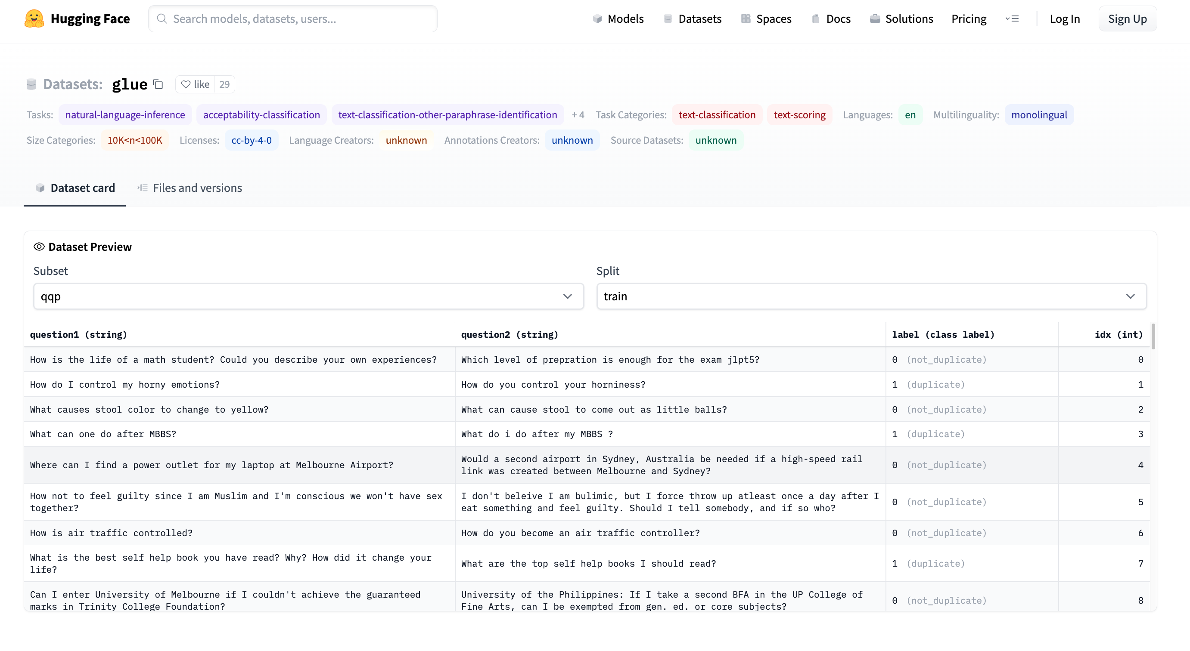
GLUE https://huggingface.co/datasets/glue/viewer/qqp/train

Slide 43
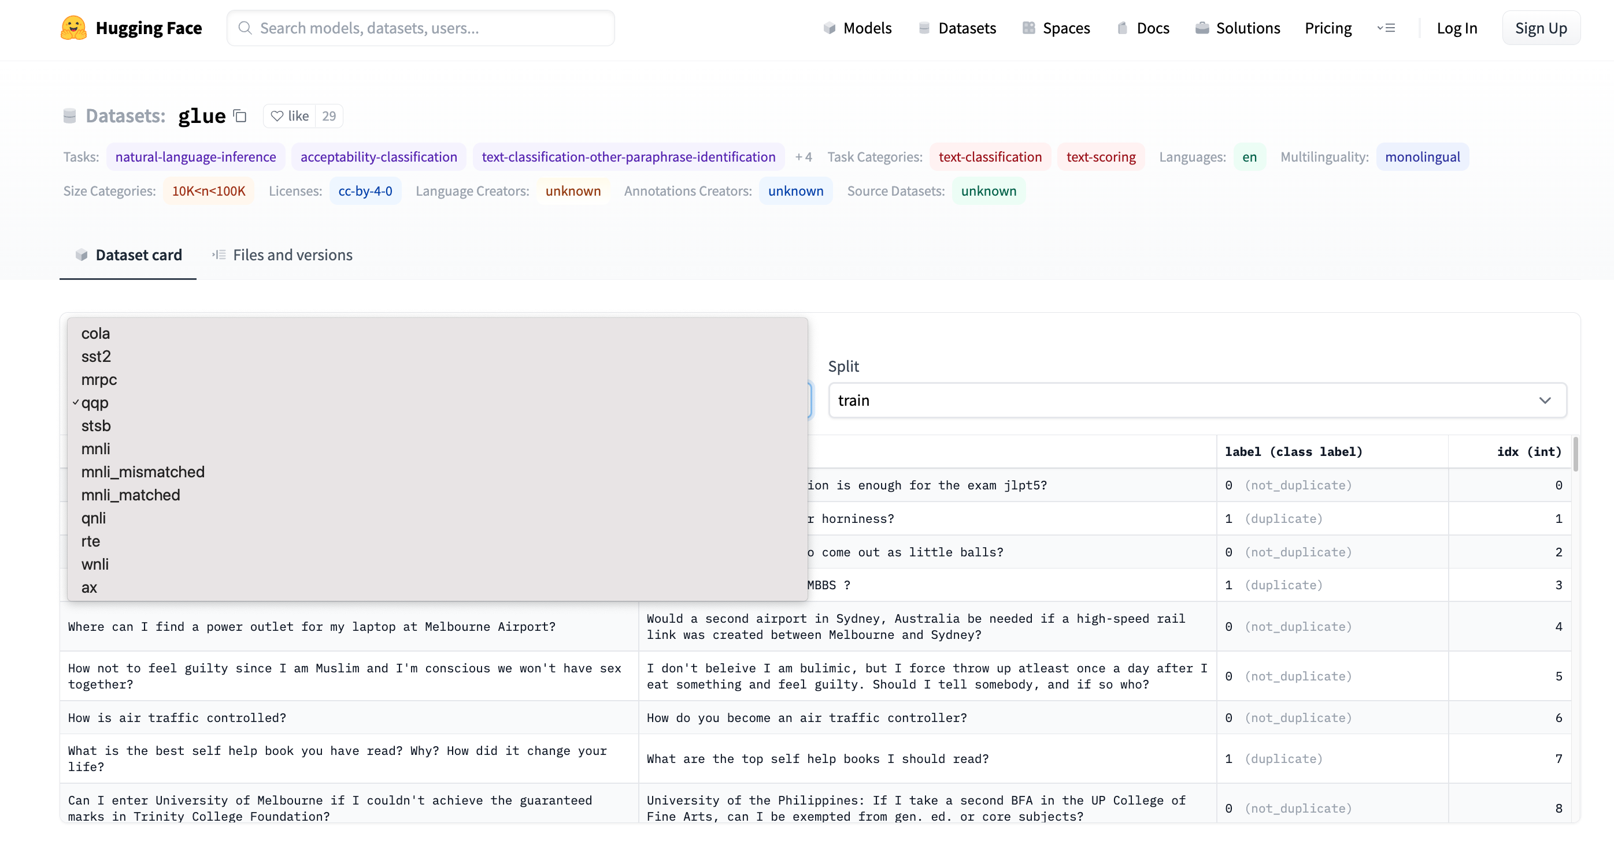
GLUE https://huggingface.co/datasets/glue/viewer/qqp/train
Terminology: Subset

Slide 44
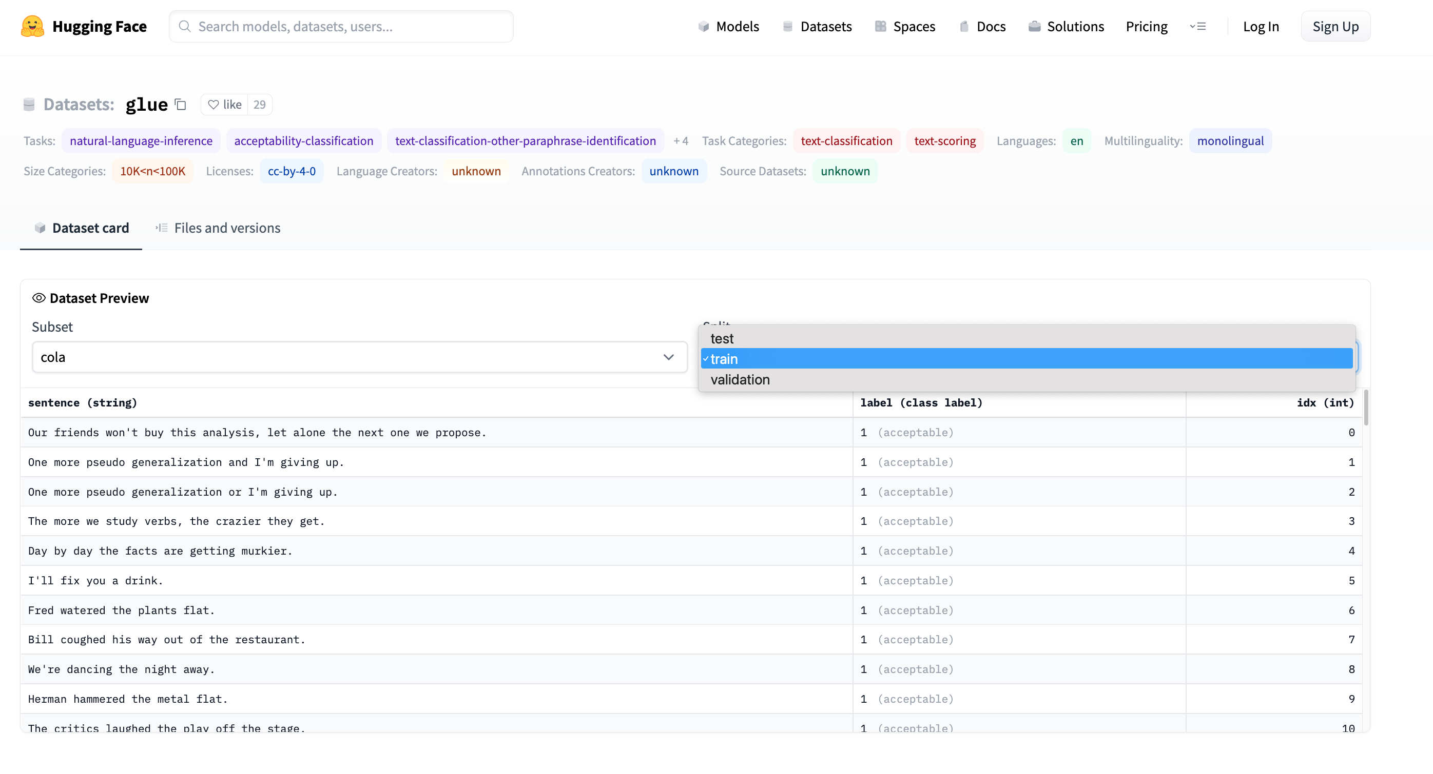
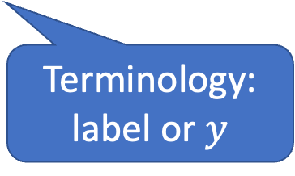
GLUE https://huggingface.co/datasets/glue/viewer/qqp/train
Terminology: Splits
Terminology:
label or $y$

Slide 45

Two Perspectives on Datasets
Machine Learning
Psychology (Presupposes $∃$Hypothesis)
Splits: train/val/test
Treat rows as iid
Identical and independently distributed
Idealistic, but maybe unrealistic
Changes over time, Context, etc.
More papers on models
than Datasets
Relatively little interest in
Is the Dataset Realistic?
Motivation? (Does anyone care? If so, who?)
What is the dataset testing?
Sampling/balance? From which population?
Can it be gamed? Leakage?
Validity
Content validity
Construct validity
Criterion validity
Face validity
Discriminant validity
Reliability
Inter-rater reliability
Test-retest reliability
Internal reliability/Inter-item consistency
Split half reliability
Lexicography

Slide 46
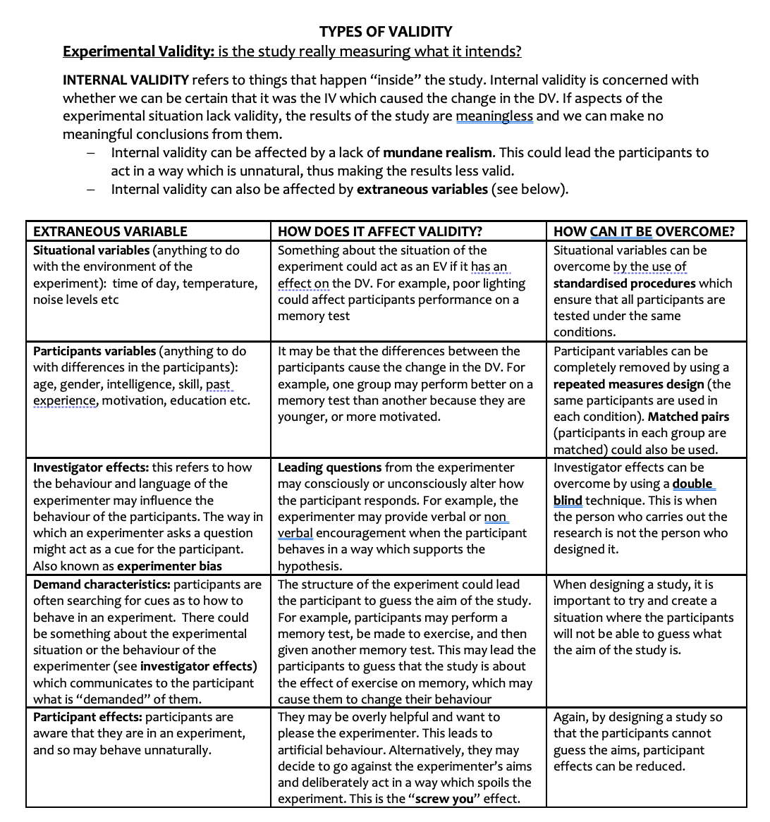
Discussion of Validity Assumes: Intention

Slide 47
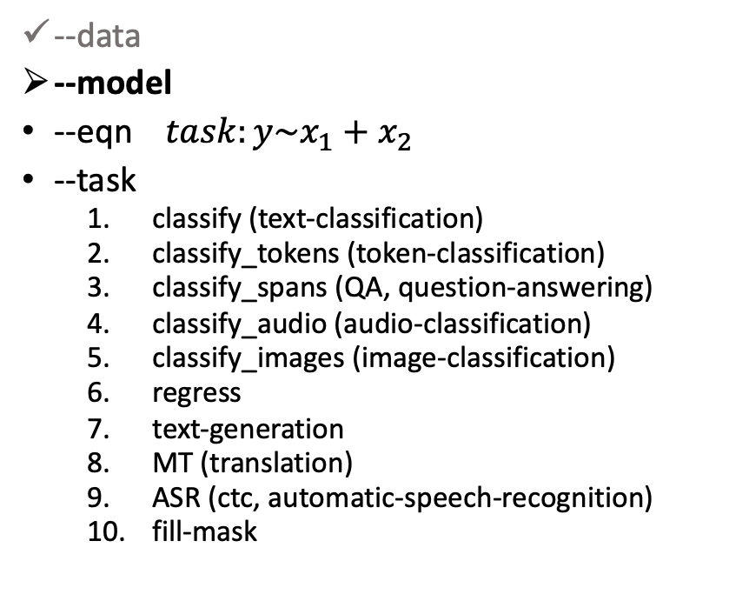
gft Cheat Sheet (General Fine-Tuning)
Next topic
4+1 Functions
4 Arguments
gft_fit: $f_{pre}$ →$f_{post}$(fine-tuning)
4 Arguments, --output_dir, --metric, --splits
(plus most args in most hubs)
gft_predict: $f\left(x\right)→\hat{y}$ (inference)
Input: 4 Arguments ($x$ from data or stdin)
Output: $\hat{y}$ for each $x$
gft_eval: Score model on dataset
Input: 4 Arguments, --split, --metric, …
Output: Score
gft_summary: Find good stuff
Input: 4 Arguments
(may include: __contains__, __infer__)
gft_cat_dataset: Output data to stdout
Input: 4 Arguments (--data, --eqn)
--data
--model
--eqn $task:y\sim x_{1}+x_{2}$
--task
classify (text-classification)
classify_tokens (token-classification)
classify_spans (QA, question-answering)
classify_audio (audio-classification)
classify_images (image-classification)
regress
text-generation
MT (translation)
ASR (ctc, automatic-speech-recognition)
fill-mask

Slide 48
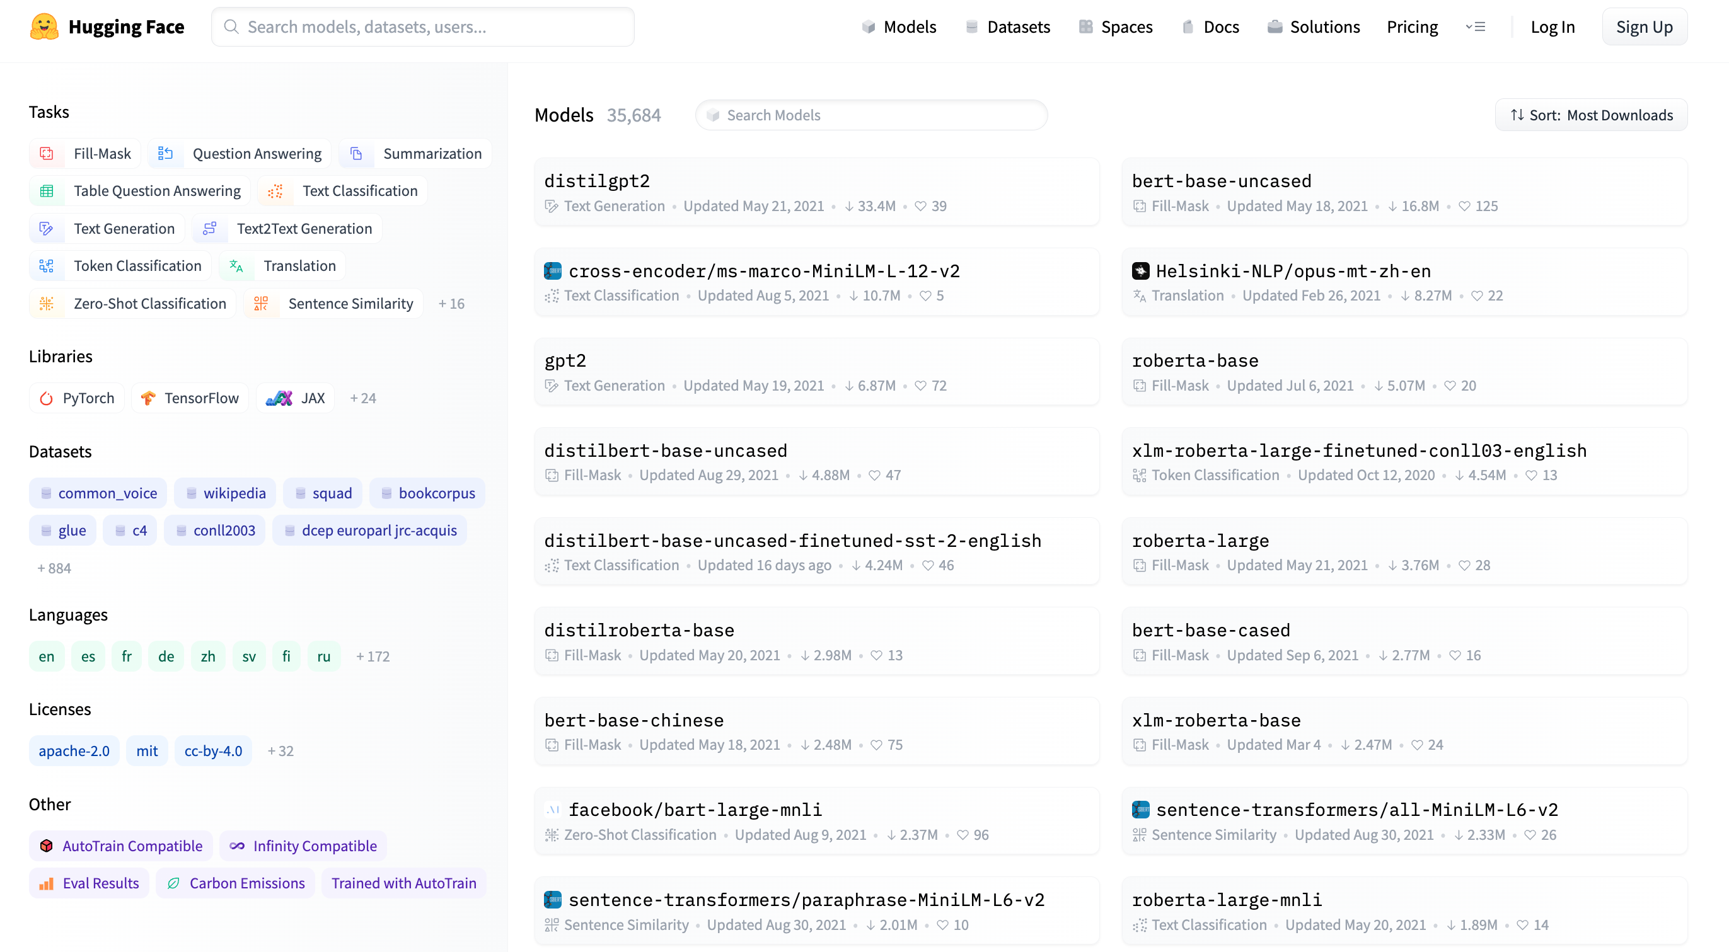
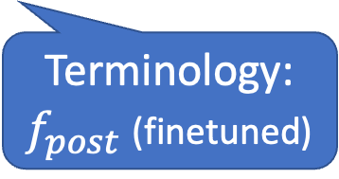
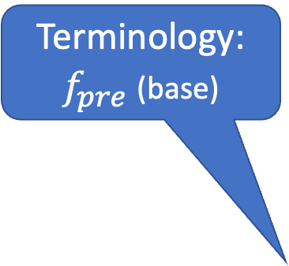



Models https://huggingface.co/models
Terminology:
$$f,f_{pre},f_{post}$$
Task:
Fill Mask
Terminology:
$f_{pre}$ (base)
Terminology:
$$f_{pre}$$
Task:
Translation
Terminology:
$f_{post}$ (finetuned)
Terminology:
$$f_{pre}$$
Task:
Token classification

Slide 49

gft Cheat Sheet (General Fine-Tuning)
4+1 Functions
4 Arguments
gft_fit: $f_{pre}$ →$f_{post}$(fine-tuning)
4 Arguments, --output_dir, --metric, --splits
(plus most args in most hubs)
gft_predict: $f\left(x\right)→\hat{y}$ (inference)
Input: 4 Arguments ($x$ from data or stdin)
Output: $\hat{y}$ for each $x$
gft_eval: Score model on dataset
Input: 4 Arguments, --split, --metric, …
Output: Score
gft_summary: Find good stuff
Input: 4 Arguments
(may include: __contains__, __infer__)
gft_cat_dataset: Output data to stdout
Input: 4 Arguments (--data, --eqn)
--data
--model
--eqn $task:y\sim x_{1}+x_{2}$
--task
classify (text-classification)
classify_tokens (token-classification)
classify_spans (QA, question-answering)
classify_audio (audio-classification)
classify_images (image-classification)
regress
text-generation
MT (translation)
ASR (ctc, automatic-speech-recognition)
fill-mask
Next topic

Slide 50

Simple Equations Cover Many Cases of Interest GLUE: A Popular Benchmark
Subset | Dataset | Equation
COLA | H:glue,cola | $$classify : label \sim sentence$$
SST2 | H:glue,sst2 | $$classify : label \sim sentence$$
WNLI | H:glue,wnli | $$classify : label \sim sentence$$
MRPC | H:glue,mrpc | $$classify : label \sim sentence1 + sentence2$$
QNLI | H:glue,qnli | $$classify : label \sim sentence1 + sentence2$$
QQP | H:glue,qqp | $$classify : label \sim question+sentence$$
SSTB | H:glue,sstb | $$regress : label \sim question1+question2$$
MNLI | H:glue,mnli | $$classify : label \sim premise+hypothesis$$

Slide 51



Loss Functions and Metrics (Defaults depend on task)
--eqn
$classify : label \sim question+sentence$
$regress : label \sim question1+question2$
Loss functions (used in gft_fit)
Classification → Cross entropy
Regression → Mean squared error
Metrics (used in gft_eval)
Classification → Accuracy
Regression → Mean squared error
--metric H:glue,cola → Matthews Correlation
Concern: Loss $≠$ Metric
Concern: Loss $≠$ Metric

Slide 52


Equation Keywords $≈$ Pipeline Tasks
Benchmark | Subset | Dataset | Equation
GLUE | COLA | H:glue,cola | $$classify : label \sim sentence$$
SQuAD 1.0 |  | H:squad | $$classify_spans:answers\sim question+context$$
SQuAD 2.0 |  | H:squad_v2 | $$classify_spans:answers\sim question+context$$
CONLL2003 | POS | H:conll2003 | $$classify_tokens:pos_tags\sim tokens$$
 | NER | H:conll2003 | $$classify_tokens:ner_tags\sim tokens$$
TIMIT |  | H:timit_asr | $$ctc :text\sim audio$$
Amazon Reviews |  | H:amazon_reviews_multi | $$classify : label \sim question+sentence$$
VAD |  | C:$gft/datasets/VAD/VAD | $$regress: Valence + Arousal + Dominance \sim Word$$

Slide 53



$$regress: Valence + Arousal + Dominance \sim Word$$ https://saifmohammad.com/WebPages/nrc-vad.html
$ℝ^{3}$

Slide 54


$$regress: Valence + Arousal + Dominance \sim Word$$ https://saifmohammad.com/WebPages/nrc-vad.html
$ℝ^{3}$
Train $f$on words, but apply $f$ to texts
(Generalizations: OOVs, MWEs, negation)

Slide 55

gft Cheat Sheet (General Fine-Tuning)
4+1 Functions
4 Arguments
gft_fit: $f_{pre}$ →$f_{post}$(fine-tuning)
4 Arguments, --output_dir, --metric, --splits
(plus most args in most hubs)
gft_predict: $f\left(x\right)→\hat{y}$ (inference)
Input: 4 Arguments ($x$ from data or stdin)
Output: $\hat{y}$ for each $x$
gft_eval: Score model on dataset
Input: 4 Arguments, --split, --metric, …
Output: Score
gft_summary: Find good stuff
Input: 4 Arguments
(may include: __contains__, __infer__)
gft_cat_dataset: Output data to stdout
Input: 4 Arguments (--data, --eqn)
--data
--model
--eqn $task:y\sim x_{1}+x_{2}$
--task
classify (text-classification)
classify_tokens (token-classification)
classify_spans (QA, question-answering)
classify_audio (audio-classification)
classify_images (image-classification)
regress
text-generation
MT (translation)
ASR (ctc, automatic-speech-recognition)
fill-mask

Slide 56





Tasks
$$y∈\left\{0,1,2,…\right\}$$
classify, text-classification
regress
QA, Question Answering, classify spans
token classification
NER (Named Entity Recognition)
POS (Part of Speech Tagging)
translation, MT
ASR, Automatic Speech Recognition, ctc
$y∈ℝ$ or $y∈ℝ^{N}$
$y$ for each start/end of span
$y$ for each token
$y$ for each phoneme

Slide 57

gft Cheat Sheet (General Fine-Tuning)
4+1 Functions
4 Arguments
gft_fit: $f_{pre}$ →$f_{post}$(fine-tuning)
4 Arguments, --output_dir, --metric, --splits
(plus most args in most hubs)
gft_predict: $f\left(x\right)→\hat{y}$ (inference)
Input: 4 Arguments ($x$ from data or stdin)
Output: $\hat{y}$ for each $x$
gft_eval: Score model on dataset
Input: 4 Arguments, --split, --metric, …
Output: Score
gft_summary: Find good stuff
Input: 4 Arguments
(may include: __contains__, __infer__)
gft_cat_dataset: Output data to stdout
Input: 4 Arguments (--data, --eqn)
--data
--model
--eqn $task:y\sim x_{1}+x_{2}$
--task
classify (text-classification)
classify_tokens (token-classification)
classify_spans (QA, question-answering)
classify_audio (audio-classification)
classify_images (image-classification)
regress
text-generation
MT (translation)
ASR (ctc, automatic-speech-recognition)
fill-mask

Slide 58
Agenda: Part A
Strategy
gft Cheatsheet
4-5 Functions + 4 Arguments
Amazing how much can be done with so little
Seven Simple Examples
More Tasks: MT, ASR, Vision
Two Questions
How do we find the good stuff?
How do we use the good stuff?
Why de-emphasize pre-training?
Conclusions

Slide 59
Seven Simple Examples
Summary
Summary with patterns (__contains__)
Predict: Sentiment Analysis & Text Classification
More tasks: token_classification, fill-mask
Input from datasets (as opposed to stdin)
gft_predict → gft_eval
gft_fit (aka fine-tuning)

Slide 60

Seven Simple Examples: 1 of 7 Summarize (almost) anything
Emotion Classes
Summarize both data and model

Slide 61
Seven Simple Examples: 2 of 7 Summary with patterns (__contains__)
Search Engine
(Embarrassment of Riches)
Find datasets on HuggingFace that contain “emotion”
Find models on HuggingFace that contain “emotion”

Slide 62
Seven Simple Examples: 3 of 7 Predict: Sentiment Analysis & Text Classification
Default model → Sentiment Analysis
Emotion Classes

Slide 63

Seven Simple Examples: 4 of 7 More tasks: token_classification, fill-mask
NER: Named Entity Recognition
Cloze (1953)
https://en.wikipedia.org/wiki/Cloze_test

Slide 64

Seven Simple Examples: 5 of 7 Input from datasets (as opposed to stdin)
Specify split
Equation specifies task & columns
Read Input from dataset
(as opposed to stdin)

Slide 65
Seven Simple Examples: 6 of 7 gft_predict → gft_eval
Eval returns a single score for the dataset split
(as opposed to a prediction for each example in dataset split)

Slide 66

A Few Simple Examples: 7 of 7 gft_fit (aka fine-tuning)
Fit returns a post-trained model: $f_{post}$

Slide 67


Recap of Seven Simple Examples
4
5
6
1
7
Summary
Summary with patterns (__contains__)
Sentiment Analysis & Text Classification
More tasks: token_classification, fill-mask
Input from datasets (as opposed to stdin)
gft_predict → gft_eval
gft_fit (aka fine-tuning)
2
3
3

Slide 68


Hundreds of Examples: https://github.com/kwchurch/gft
Subdirectories under $gft/examples
4 Functions
fit_examples
predict_examples
eval_examples
summary_examples
Look for *.sh files under these directories
find $gft/examples –name ”*.sh”
4 arguments:
--data, --model, --eqn, --task
gft_fit: $f_{pre}$ →$f_{post}$(fine-tuning)
4 Arguments, --output_dir, --metric, --splits
(plus most args in most hubs)
gft_predict: $f\left(x\right)→\hat{y}$ (inference)
Input: 4 Arguments ($x$ from data or stdin)
Output: $\hat{y}$ for each $x$
gft_eval: Score model on dataset
Input: 4 Arguments, --metric, …
Output: Score
gft_summary: Find good stuff
4 Arguments
(may include: __contains__, __infer__)

Slide 69


Hundreds of Examples: Regression Testing
Regression testing looks for errors in output
Input
Output
Pass: No Errors
https://github.com/kwchurch/gft/blob/master/examples/summary_examples/model/model.HuggingFace/roberta-base.sh

Slide 70

Guide to Hundreds of Examples
Subdirectories under $gft/examples
Naming Conventions
fit_examples (1 arg)
--output_dir $1
predict_examples (0 args)
eval_examples (0 args)
summary_examples (0 args)
Look for *.sh files under these directories
find $gft/examples –name ”*.sh”
4 arguments:
--data, --model, --eqn, --task
Function
fit, predict, eval, summary
Models
model.HuggingFace/model.Paddle
our_models/their_models
Data
data.HuggingFace/data.Paddle
Benchmarks/Tasks
GLUE, SQuAD, sentiment,…
Hyper-parameter Tuning

Slide 71
Cola subset of Glue, with pretrained models and data from HuggingFace $gft/examples/eval_examples/model.HuggingFace/language/data.HuggingFace/their_models/glue/cola.sh
Input
Output (Sorted by score; 4 errors removed)
for model in textattack/distilbert-base-uncased-CoLA textattack/bert-base-uncased-CoLA textattack/distilbert-base-cased-CoLA textattack/roberta-base-CoLA cointegrated/roberta-large-cola-krishna2020 textattack/albert-base-v2-CoLA gchhablani/bert-base-cased-finetuned-cola yoshitomo-matsubara/bert-base-uncased-cola howey/roberta-large-cola textattack/xlnet-base-cased-CoLA isakbos/Q8BERT_COLA_L_512 EhsanAghazadeh/bert-large-uncased-CoLA_A EhsanAghazadeh/bert-large-uncased-CoLA_B 09panesara/distilbert-base-uncased-finetuned-cola yoshitomo-matsubara/bert-large-uncased-cola textattack/xlnet-large-cased-CoLA Alireza1044/albert-base-v2-cola pmthangk09/bert-base-uncased-glue-cola kamivao/autonlp-cola_gram-208681 mrm8488/deberta-v3-small-finetuned-cola 123abhiALFLKFO/distilbert-base-uncased-finetuned-cola Ahren09/distilbert-base-uncased-finetuned-cola
do
gft_eval --data H:glue,cola --split val \
--eqn 'classify: label ~ sentence’ --model H:$model \
--metric H:glue,cola --figure_of_merit matthews_correlation
done
Model | Score | Seconds
howey/roberta-large-cola | 0.65 | 3.93
textattack/roberta-base-CoLA | 0.64 | 1.6
yoshitomo-matsubara/bert-large-uncased-cola | 0.63 | 5.12
mrm8488/deberta-v3-small-finetuned-cola | 0.63 | 1.62
EhsanAghazadeh/bert-large-uncased-CoLA_A | 0.61 | 4.05
yoshitomo-matsubara/bert-base-uncased-cola | 0.61 | 1.58
EhsanAghazadeh/bert-large-uncased-CoLA_B | 0.60 | 4.13
gchhablani/bert-base-cased-finetuned-cola | 0.60 | 1.57
pmthangk09/bert-base-uncased-glue-cola | 0.58 | 1.53
textattack/albert-base-v2-CoLA | 0.58 | 1.59
textattack/distilbert-base-uncased-CoLA | 0.57 | 1.04
kamivao/autonlp-cola_gram-208681 | 0.56 | 1.52
Alireza1044/albert-base-v2-cola | 0.55 | 1.71
09panesara/distilbert-base-uncased-finetuned-cola | 0.54 | 0.87
textattack/bert-base-uncased-CoLA | 0.53 | 2.35
123abhiALFLKFO/distilbert-base-uncased-finetuned-cola | 0.53 | 0.9
textattack/xlnet-base-cased-CoLA | 0.50 | 2.23
textattack/distilbert-base-cased-CoLA | 0.46 | 0.88
isakbos/Q8BERT_COLA_L_512 | 0.00 | 1.77
textattack/xlnet-large-cased-CoLA | 0.00 | 5.08
cointegrated/roberta-large-cola-krishna2020 | -0.65 | 4.31
Popular models containing “cola”
(not SOTA)

Slide 72

What is ``Good’’ Stuff? Accuracy? Downloads?
Hyper-Parameter Tuning → Small Gains
Best of Hubs
SOTA
Should not compare accuracy across splits
Should not compare accuracy across splits
Best of Hubs are good
(but probably not SOTA)

Slide 73
Agenda: Part A
Strategy
gft Cheatsheet
4-5 Functions + 4 Arguments
Amazing how much can be done with so little
Seven Simple Examples
More Tasks: MT, ASR, Vision
Two Questions
How do we find the good stuff?
How do we use the good stuff?
Why de-emphasize pre-training?
Conclusions

Slide 74

More tasks (1 of 4)
Text Classification
Token Classification
Fill Mask
Text Generation
Machine Translation

Slide 75
More tasks (2 of 4)
Text Classification
Token Classification
Fill Mask
Text Generation
Machine Translation

Slide 76
More tasks (3 of 4)
Text Classification
Token Classification
Fill Mask
Text Generation
Machine Translation
Output is non-deterministic

Slide 77
More tasks (4 of 4)
Text Classification
Token Classification
Fill Mask
Text Generation
Machine Translation

Slide 78
More tasks (4 of 4)
Text Classification
Token Classification
Fill Mask
Text Generation
Machine Translation
English → French
English → Chinese
A Model for: English → French
A Model for: English → Chinese

Slide 79


gft_predict –task image-classification
Default Model → 1000 Labels
A Model with Cat/Dog Labels

Slide 80



History behind Cat/Dog Task

Slide 81


Inputs can also come from files (as well as URLs) There are a few images (and audio files) under $gft/doc/objects

Slide 82




Task: Speech Recognition (ASR, ctc)
Input from stdin
Input from dataset

Slide 83

--task argument → HuggingFace Pipelines https://huggingface.co/docs/transformers/v4.16.2/en/main_classes/pipelines

Slide 84
Agenda: Part A
Strategy
gft Cheatsheet
4-5 Functions + 4 Arguments
Amazing how much can be done with so little
Seven Simple Examples
More Tasks: MT, ASR, Vision
Two Questions
How do we find the good stuff?
How do we use the good stuff?
Why de-emphasize pre-training?
Conclusions

Slide 85
Two Questions
How do I find the good stuff?
And how do I use the good stuff?
Presupposition:
Hubs encourage sharing of
Datasets
Models
Tasks

Slide 86
Embarrassment of Riches
Hubs have 40k models & 4k datasets (increasing 3x per year)
Q: How can I find the good stuff?
A: gft_summary

Slide 87

Metrics of Success: How do we find good stuff?
Algo Search: Left Rail
vs
Ad Search: Right Rail
A kind of search engine
Score dataset by:
# of downloads
# of likes
# of models
# of citations

Slide 88
How do I find the good stuff? Popular Datasets? gft_summary –data H:__contains__wiki --topn 20
Dataset | Downloads | Likes | PWC
wikitext | 119,031 | 7 | https://paperswithcode.com/dataset/wikitext-2
wikiann | 20,021 | 6 | https://paperswithcode.com/dataset/wikiann-1
wiki_snippets | 16,550 | 0
wikipedia | 14,729 | 8
wiki_bio | 10,135 | 0 | https://paperswithcode.com/dataset/wikibio
wiki_qa | 9,670 | 1 | https://paperswithcode.com/dataset/wikiqa
wiki_hop | 8,961 | 0 | https://paperswithcode.com/dataset/wikihop
wiki_dpr | 5,310 | 0
wiki_split | 5,260 | 0 | https://paperswithcode.com/dataset/wikisplit
wiki40b | 2,618 | 3 | https://paperswithcode.com/dataset/wiki-40b
wikisql | 2,135 | 2 | https://paperswithcode.com/dataset/wikisql
wikihow | 1,601 | 0 | https://paperswithcode.com/dataset/wikihow
wiki_lingua | 1,508 | 1 | https://paperswithcode.com/dataset/wikilingua
kilt_wikipedia | 1,421 | 2
Tevatron/wikipedia-nq-corpus | 1,368 | 0
wiki_auto | 1,258 | 0
wiki_asp | 1,192 | 1 | https://paperswithcode.com/dataset/wikiasp
wikicorpus | 1,098 | 0
wiki_atomic_edits | 1,058 | 3 | https://paperswithcode.com/dataset/wikiatomicedits
iapp_wiki_qa_squad | 1,033 | 0

Slide 89
How do I find the good stuff? Popular Datasets? gft_summary –data H:__contains__ --topn 20
Dataset | Downloads | Likes | PWC
glue | 926,082 | 26 | https://paperswithcode.com/dataset/glue
super_glue | 306,473 | 9 | https://paperswithcode.com/dataset/superglue
wikitext | 119,031 | 7 | https://paperswithcode.com/dataset/wikitext-2
imdb | 105,321 | 8 | https://paperswithcode.com/dataset/imdb-movie-reviews
squad | 99,954 | 22 | https://paperswithcode.com/dataset/squad
squad_es | 72,163 | 0 | https://paperswithcode.com/dataset/squad-es
paws | 65,433 | 1 | https://paperswithcode.com/dataset/paws
librispeech_asr | 65,325 | 12 | https://paperswithcode.com/dataset/librispeech-1
wmt16 | 48,479 | 2 | https://paperswithcode.com/dataset/wmt-2016
xnli | 41,987 | 5 | https://paperswithcode.com/dataset/xnli
snli | 34,045 | 5 | https://paperswithcode.com/dataset/snli
ag_news | 30,456 | 11 | https://paperswithcode.com/dataset/ag-news
anli | 30,245 | 3 | https://paperswithcode.com/dataset/anli
amazon_polarity | 28,584 | 6
squad_v2 | 28,000 | 3 | https://paperswithcode.com/dataset/squad
conll2003 | 26,012 | 11 | https://paperswithcode.com/dataset/conll-2003
red_caps | 25,940 | 2 | https://paperswithcode.com/dataset/redcaps
common_voice | 25,033 | 26 | https://paperswithcode.com/dataset/common-voice
stsb_multi_mt | 23,866 | 4
trec | 23,313 | 3 | https://paperswithcode.com/dataset/trecqa

Slide 90

gft_summary: How do I find the good stuff? Find models associated with a task (ASR)
task → list of models (by downloads)

Slide 91

gft_summary: How do I find the good stuff? Find models associated with a task (ASR)
task → list of models (by downloads)
dataset → list of models (by downloads)

Slide 92

gft_summary: How do I find the good stuff? Find popular models associated with a dataset

Slide 93

gft_summary: How do I find the good stuff? Find popular models associated with a task (MT)

Slide 94
Embarrassment of Riches
Hubs have 30k models & 3k datasets (increasing 3x per year)
Q: How can I find the good stuff?
A: gft_summary
__contains__
Find popular models/datasets that contain substring
__infer__
Find popular models that are associated with task/dataset
Examples:
gft_summary --data H:__contains__emotion --topn 5
gft_summary --model H:__contains__emotion --topn 5
gft_summary --task H:classify --model H:__infer__ --topn 5
gft_summary --data H:emotion --model H:__infer__ --topn 5

Slide 95

What counts as ``good’’ stuff?
Large Model
(RoBERTa Large)
Many Downloads, but not SOTA
Academic Metrics:
Peer Review (Citations)
Social Media Metrics:
Popular (Downloads)
Tweets / Blogs
SOTA: State of the art
Papers with Code
Leaderboards
Search Engine Optimization (SEO)
Adversarial Game (Arbitrage):
Better Web Search → ``Better’’ SEOs → Better Web Search
Compressed (distilbert)
Compressed (distilbert)
Ease-of-Use

Slide 96
SOTA-Chasing: Leaderboards Considered Harmful SOTA-chasing refers to papers that report SOTA numbers, but contribute little of lasting value to the literature. The point is the pointlessness.

Slide 97

PWC: https://paperswithcode.com/dataset/glue

Slide 98


PWC $≠$GLUE Leaderboard

Slide 99
How do I find ``good’’ tasks?
``Good’’ tasks are like ``good’’ stuff
Academic Metrics:
Peer Review (Citations)
Social Media Metrics:
Popular (Downloads)
Tweets / Blogs
SOTA: State of the art
Papers with Code
Leaderboards
Search Engine Optimization (SEO)
Adversarial Game (Arbitrage):
Better Web Search → ``Better’’ SEOs → Better Web Search

Slide 100

Equation Keywords $≈$ Pipeline Tasks
Task | Subtask | Dataset | Equation
GLUE | COLA | H:glue,cola | $$classify : label \sim sentence$$
SQuAD 1.0 |  | H:squad | $$classify_spans:answers\sim question+context$$
SQuAD 2.0 |  | H:squad_v2 | $$classify_spans:answers\sim question+context$$
CONLL2003 | POS | H:conll2003 | $$classify_tokens:pos_tags\sim tokens$$
 | NER | H:conll2003 | $$classify_tokens:ner_tags\sim tokens$$
TIMIT |  | H:timit_asr | $$ctc :text\sim audio$$
Amazon Reviews |  | H:amazon_reviews_multi | $$classify : label \sim question+sentence$$
VAD |  | C:$gft/datasets/VAD/VAD | $$regress: Valence + Arousal + Dominance \sim Word$$

Slide 101
Two Questions
How do I find the good stuff?
And how do I use the good stuff?
A: gft_predict

Slide 102



Question: How do I use the good stuff? Answer: gft_predict
$$f\left(x\right)→\hat{y}$$
No model specified
$$x$$
$$\hat{y}$$
Score

Slide 103
Input: I love you Output: Depends on Model (among other things)
Task: classify
Models:
Sentiment
Expected output label: positive
Fake News:
Expected output label: not fake (real)
Spam/Ham:
Expected output label: not spam (ham)
for model in …
do
echo I love you |
gft_predict \
--task classify \
--model $model
done

Slide 104
Many of these models produce reasonable results
Scores could be more confident

Slide 105
But…

Slide 106

Debugging, Confusion Matrices & Error Analysis

Slide 107

Inference: gft_predict
gft_predict
Input from a dataset or stdin
Output to stdout
Arguments (many are optional)
--data, --split, --model, --eqn, --task
--eqn $task: lhs \sim rhs$
Variables in $lhs$ and $rhs$
refer to columns in dataset
Since the terminology for tasks is currently in a state of flux,
gft supports a number of aliases
(shown in parentheses)
Tasks (aliases in parenthesis)
classify (text-classification)
classify_tokens
(token-classification)
classify_spans
(QA, question-answering)
classify_audio (audio-classification)
classify_images (image-classification)
regress
text-generation
MT (translation)
ASR
(ctc, automatic-speech-recognition)
fill-mask

Slide 108
Agenda: Part A
Strategy
gft Cheatsheet
4-5 Functions + 4 Arguments
Amazing how much can be done with so little
Seven Simple Examples
More Tasks: MT, ASR, Vision
Two Questions
How do we find the good stuff?
How do we use the good stuff?
Why de-emphasize pre-training?
Conclusions

Slide 109
Why De-emphasize Pre-Training?

Slide 110
Standard 3-Step Recipe
One-Time
$$$$
(Cost)
Recurring
$
less cost;
more profit

Slide 111








Models https://huggingface.co/models
Terminology:
$$f,f_{pre},f_{post}$$
Terminology:
Compressed $f_{pre}$
Terminology:
Compressed $f_{pre}$
Terminology:
Compressed $f_{pre}$
Terminology:
Compressed $f_{pre}$
Terminology:
$f_{pre}$ (base)
Terminology:
$$f_{pre}$$
Terminology:
$$f_{post}$$
Terminology:
$$f_{pre}$$

Slide 112


Model Compression (Distillation): Important for Commercial Practice
Popular Choices on Hubs
Model Compression:
Trade-offs: Size vs. Accuracy
Pick any two
Compressed
https://arxiv.org/pdf/2002.11985.pdf
Compressed

Slide 113





Lesson: Focus on Bottlenecks
Bottleneck for Global Warming:
$$cost\left(transportation\right)≫5 cars$$
$$cost\left(smart speakers\right)≫5 cars$$
Commercial Practice: $cost(inference) ≫ cost(training)$
Commercial Practice: $cost(inference) ≫ cost(training)$
Fixed Costs: One-time up-front
Training Costs $≈$5 cars
Variable Costs: Recurring costs
Inference Costs $≫$5 cars
Deploy a model to 1B people
Who use it every day (for years)
If the application goes viral (success)
$variable costs≫fixed costs$
$cost(inference) ≫ cost(training)$
Relatively small

Slide 114


Base/Foundation/Pre-Trained Models Recommendation: Download $f_{pre}$from Hubs
Some Popular Pre-Trained Models: $f_{pre}$
Some Popular Datasets for Pre-Training
DDI → Don’t Do It (yourself)

Slide 115


Bigger Models are Better (but less efficient)
Data Source: Microsoft blog (https://syncedreview.com/2020/02/12/17-billion-parameters-microsoft-deepspeed-breeds-worlds-largest-nlp-model/) and Kunle Olukton’s presentation at ScaledML
Industry-only
(too expective for academia)
Industry-only
(too expensive for academia)
17b Parameters
1000 GPUs
6% efficiency
8b Parameters
512 GPUs
20% efficiency

Slide 116



540B Parameters: https://arxiv.org/pdf/2204.02311.pdf
Industry-only
(too expective for academia)

Slide 117
Bigger Models are Better (but less efficient)
Data Source: Microsoft blog (https://syncedreview.com/2020/02/12/17-billion-parameters-microsoft-deepspeed-breeds-worlds-largest-nlp-model/) and Kunle Olukton’s presentation at ScaledML
Industry-only
(too expective for academia)
Industry-only
(too expective for academia)
17b Parameters
1000 GPUs
6% efficiency
8b Parameters
512 GPUs
20% efficiency

Slide 118

540B Parameters: More Parameters → Better Scores More Supervision → Better Scores

Slide 119

Strengths and Opportunities
Industrial Scale SOTA-Chasing
Opportunities for the Masses
Strengths
$$
Staff (size of staff)
Logistics
Weaknesses
Risk-adverse
Big $$ → Too Big to Fail
Smaller projects → Creativity
Martial Arts:
Use their strengths to your advantage
Community
Large: $\left|students\right|≫|staff|$
Willingness to share: github, arXiv
Standards!!
(Builds Community)
Examples: PyTorch, gft

Slide 120



Hubs: PyTorch is Popular ($25k≫6k$) On HuggingFace, PyTorch > JAX > TensorFlow
Ease-of-Use >> System Performance
25k PyTorch Models
6k JAX Models

Slide 121


Why Change Terminology?
More opportunity for academics
& Computational Linguistics
Standard Terminology | Proposed Alternatives
Base/Foundation/Pre-Trained | $$f_{pre}$$
Fine-Tuning | fit
Inference | predict
Not this
Emphasize this
Emphasize this
https://www.youtube.com/watch?v=dG628PEN1fY
Industry has an ``unfair advantage’’ over academia
Pre-training requires $$$$, Big Data & Logistics:
Big Investments → Risk Adverse → Less Creativity

Slide 122


VLSI History http://www.eecs.mit.edu/docs/newsletter/VLSI.pdf http://ai.eecs.umich.edu/people/conway/Memoirs/MIT/MIT_Reminiscences.pdf
Perspective from MIT and beyond:
IBM, Silicon Valley, Mich, LGBTQ, etc.
Think of $f_{pre}$ like Intel CPU chips
Universities can afford
to program CPUs and models (fit/predict)
but not VLSI fabrication ($f_{pre}$)
Jon Allen (my thesis advisor at MIT)
Invested big $$$$ in VLSI fabrication
Big $$$$ → (Too) Much Responsibility
Creativity requires willingness to take risks
Industry can afford to work on projects
with industrial challenges/rewards:
Capital, ROI, Scale, Logistics
Academics have other priorities:
Bottom line: $fit/predict ≫f_{pre}$

Slide 123
Agenda: Part A
Strategy
gft Cheatsheet
4-5 Functions + 4 Arguments
Amazing how much can be done with so little
Seven Simple Examples
More Tasks: MT, ASR, Vision
Two Questions
How do we find the good stuff?
How do we use the good stuff?
Why de-emphasize pre-training?
Conclusions

Slide 124

Advantages of Higher-Level Little Languages
Ease of use
Accessible to broader audience
Hide complexity
1-line of gft $≪$ 800+ lines of python
More transparency; fewer bugs
Encourage community
Sharing data, models, tasks
Replication
Avoid special cases
Standard examples on hubs
expect users to modify python
different programs for different datasets/models/tasks
gft encourages code re-use
gft uses same code as examples
with same performance and computational costs
but generalizes over more datasets/models/tasks
Portability across suppliers
Mix and Match Across Hubs
(HuggingFace, PaddleNLP)

Slide 125
Part A Conclusions
See github for code & examples
Amazing how much can be done with so little
Higher level (little) languages like gft have many advantages over examples found on hubs:
Short (1-line) programs are
easier to read and write,
more transparent and
more portable (across hubs)
Inclusiveness
Accessible to masses
Demystify deep nets
No one would suggest regression-like methods are ``intelligent’’
Teaser for Part B:
To improve over Part A, we recommend Interdisciplinary combo
Deep Nets (recent progress)
AI Representation (decades)
Linguistics & Philosophy (centuries)

Slide 126

What are the most popular tasks? 30k Models → Pipeline Tasks (computed from $gft/gft_internals/huggingface_hub/huggingface_datasets.txt)
Models | Pipeline Task
9537 | None
3949 | text-generation
3143 | text-classification (classify)
2390 | fill-mask
2253 | text2text-generation
1508 | automatic-speech-recognition (ctc)
1460 | translation
1340 | token-classification (classify_tokens)
1042 | conversational
983 | question-answering (classify_spans)
982 | feature-extraction
338 | sentence-similarity
320 | summarization
261 | image-classification
Models | Pipeline Task
160 | text-to-speech
68 | zero-shot-classification
55 | audio-to-audio
54 | audio-classification
26 | table-question-answering
12 | object-detection
11 | image-segmentation
9 | text-to-image
4 | structured-data-classification
4 | image-to-text
2 | voice-activity-detection
1 | zero-shot-image-classification
1 | speech-segmentation
1 | protein-folding
1 | pipeline_tag
$f_{pre}$: Pre-trained Model

Slide 127

30k Models → Pipeline Tasks (computed from $gft/gft_internals/huggingface_hub/huggingface_datasets.txt)
Models | Pipeline Task
9537 | None
3949 | text-generation
3143 | text-classification (classify)
2390 | fill-mask
2253 | text2text-generation
1508 | automatic-speech-recognition (ctc)
1460 | translation
1340 | token-classification (classify_tokens)
1042 | conversational
983 | question-answering (classify_spans)
982 | feature-extraction
338 | sentence-similarity
320 | summarization
261 | image-classification
Models | Pipeline Task
160 | text-to-speech
68 | zero-shot-classification
55 | audio-to-audio
54 | audio-classification
26 | table-question-answering
12 | object-detection
11 | image-segmentation
9 | text-to-image
4 | structured-data-classification
4 | image-to-text
2 | voice-activity-detection
1 | zero-shot-image-classification
1 | speech-segmentation
1 | protein-folding
1 | pipeline_tag

